Slide 1
The Cloud, DevOps, and the Changing Face of Modern Operations
LOPSA East Tennessee January 2016

Slide 2
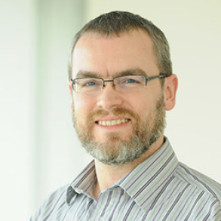
Andy Cowell has over twenty years of system administration experience in a variety of environments. Currently, he works for Scripps Networks as the manager of the Application Engineering and Automation group, which is responsible for a large number and wide variety of environments, from legacy Windows apps to DevOps-style Linux web deployments, both on-prem and in the cloud. He has been responsible for some of the top destinations on the Internet, such as HGTV.com, Dilbert.com, and Metallica.com. In the past, he has worn many hats, from networking admin to full-time developer, and cut his teeth as a "wizard" with the UTK Computer Science department.
When not wrangling systems, he solders microcontrollers, paints toy soldiers, drinks bourbon, smokes pipes, and rolls 20s.

Slide 3
Who here has participated in building out a data center?
Notes:
How long does it take?
How much money does it cost?
How difficult is it?
Power, cooling, cables, weight, insurance, weather patterns, etc...

Slide 4
Who here has participated in building out a data center?
I think we can agree that, in general, building out a data center is time consuming, expensive, and difficult.

Slide 5
What is the Cloud?

Slide 6
The NIST Definition of Cloud Computing (SP 800-145) Essentials
On-demand self-service. A consumer can unilaterally provision computing capabilities, such as server time and network storage, as needed automatically without requiring human interaction with each service’s provider.
Broad network access. Capabilities are available over the network and accessed through standard mechanisms that promote use by heterogeneous thin or thick client platforms (e.g., mobile phones, tablets, laptops, and workstations).
Resource pooling. The provider’s computing resources are pooled to serve multiple consumers using a multi-tenant model, with different physical and virtual resources dynamically assigned and reassigned according to consumer demand. There is a sense of location independence in that the customer generally has no control or knowledge over the exact location of the provided resources but may be able to specify location at a higher level of abstraction (e.g., country, state, or datacenter). Examples of resources include storage, processing, memory, and network bandwidth.
Rapid elasticity. Capabilities can be rapidly and elastically provisioned, in some cases automatically, to scale rapidly outward and inward commensurate with demand. To the consumer, the capabilities available for provisioning often appear to be unlimited and can be appropriated in any quantity at any time.
Measured Service. Cloud systems automatically control and optimize resource use by leveraging a metering capability1 at some level of abstraction appropriate to the type of service (e.g., storage, processing, bandwidth, and active user accounts). Resource usage can be monitored, controlled, and reported, providing transparency for both the provider and consumer of the utilized service.
Notes:
A whole organization dedicated to definitions says…

Slide 7
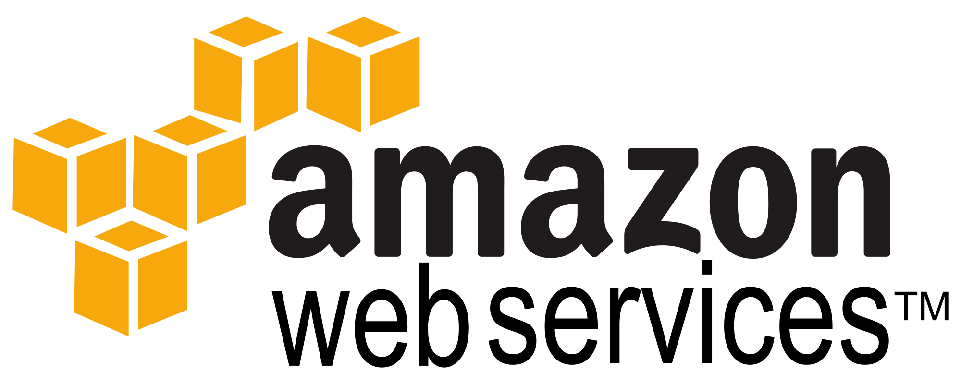
De facto definition:

Slide 8
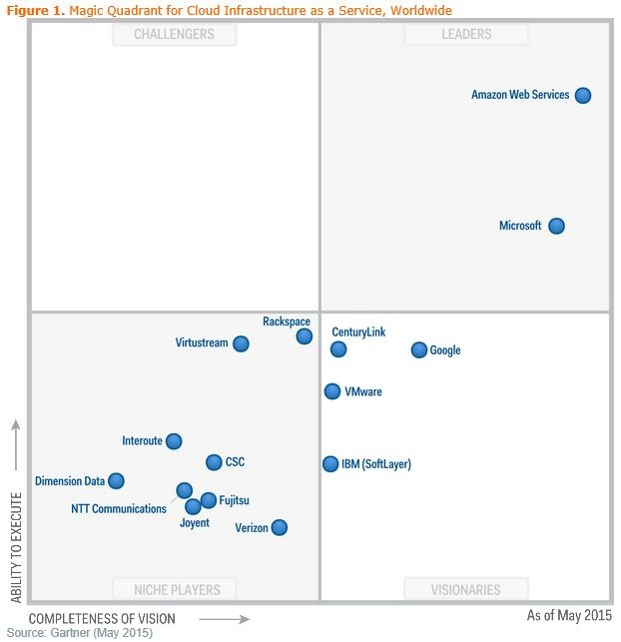

Slide 9
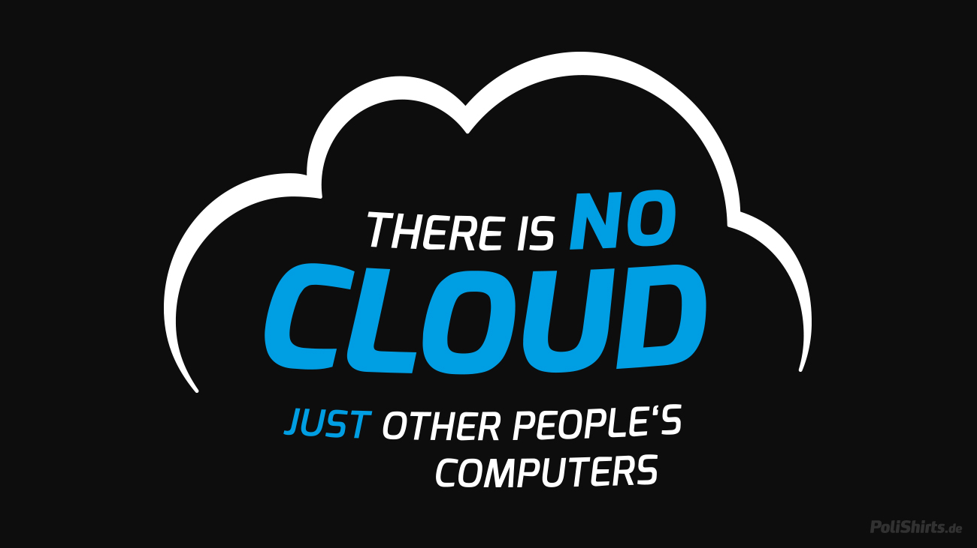
Notes:
We had other people’s computers 30 years ago,,,

Slide 10

Notes:
So, what is the could then...?

Slide 11
The NIST Definition of Cloud Computing (SP 800-145) Essentials
On-demand self-service. A consumer can unilaterally provision computing capabilities, such as server time and network storage, as needed automatically without requiring human interaction with each service’s provider.
Broad network access. Capabilities are available over the network and accessed through standard mechanisms that promote use by heterogeneous thin or thick client platforms (e.g., mobile phones, tablets, laptops, and workstations).
Resource pooling. The provider’s computing resources are pooled to serve multiple consumers using a multi-tenant model, with different physical and virtual resources dynamically assigned and reassigned according to consumer demand. There is a sense of location independence in that the customer generally has no control or knowledge over the exact location of the provided resources but may be able to specify location at a higher level of abstraction (e.g., country, state, or datacenter). Examples of resources include storage, processing, memory, and network bandwidth.
Rapid elasticity. Capabilities can be rapidly and elastically provisioned, in some cases automatically, to scale rapidly outward and inward commensurate with demand. To the consumer, the capabilities available for provisioning often appear to be unlimited and can be appropriated in any quantity at any time.
Measured Service. Cloud systems automatically control and optimize resource use by leveraging a metering capability1 at some level of abstraction appropriate to the type of service (e.g., storage, processing, bandwidth, and active user accounts). Resource usage can be monitored, controlled, and reported, providing transparency for both the provider and consumer of the utilized service.
These are the key parts, IMO.

Slide 12
“…unilaterally provision computing capabilities…as needed automatically without requiring human interaction…through standard mechanisms…”
API driven infrastructure

Slide 13
API driven infrastructure implies there is, in practicality, no barrier between the end user and unlimited infrastructure.
What’s the implication?
It’s no longer necessary to have anything like the data center buildout to bring a new product to market. Months to years of waiting, millions of sunk capital cost up front, all to find out whether or not the product is a success is now replaced with a credit card and a handful of scripts!
Companies can now launch products, judge success or failure, and either invest more, pivot the product, or cancel and refocus on another product before the ground would have been broken on a data center.
It’s top line thinking, revenue growth thinking, instead of bottom line thinking, cost cutting thinking.
Notes:
Compare and contrast with data center.
Note this is always a cost/benefit analysis.
Operations usually in bottom line thinking.

Slide 14
API driven infrastructure implies there is, in practicality, no barrier between the end user and unlimited infrastructure.
Who does this impact?
Developers, for one.
For years, every time they want to launch a new product, they have been held up at Operations. Do we have the servers? No, we need to order new servers. What about a load balancer? It’s about maxxed out, can’t use it unless we upgrade. And oh yeah, we don’t have network switches, so we need to order some of those. By the way, the data center is maxxed out on cooling and/or power, so…Operations gets the reputation for being an obstacle which must be overcome.
The cloud allows them to get around all this. With their corporate purchasing card and an amount small enough for their manager to approve and justify, they can get their product started today.

Slide 15
What is DevOps?

Slide 16
What is DevOps?
DevOps is fundamentally nothing more than Operations in support of Developers…

Slide 17
What is DevOps?
DevOps is fundamentally nothing more than Operations in support of Agile Developers in a world where you can “…unilaterally provision computing capabilities…as needed automatically without requiring human interaction…”
What is Agile?
Agile Software Development is a set of software development methods in which requirements and solutions evolve through collaboration between self-organizing, cross-functional teams. It promotes adaptive planning, evolutionary development, early delivery, continuous improvement, and encourages rapid and flexible response to change.
https://en.wikipedia.org/wiki/Agile_software_development

Slide 18
What is DevOps?
DevOps (a clipped compound of "development" and "operations") is a culture, movement or practice that emphasizes the collaboration and communication of both software developers and other information-technology (IT) professionals while automating the process of software delivery and infrastructure changes. It aims at establishing a culture and environment where building, testing, and releasing software, can happen rapidly, frequently, and more reliably.
https://en.wikipedia.org/wiki/DevOps
Notes:
Collaboration.
Speed.

Slide 19
But Andy, I don’t support developers!
There are a lot of tools and techniques that everybody can take away from DevOps, whether or not you operate in support of developers– most of which involve increasing the “flow” of work, generalizing skill sets, and automation around the API driven infrastructure.
Notes:
Note the distinction between the build and the install process.

Slide 20
A few key concepts of DevOps

Slide 21
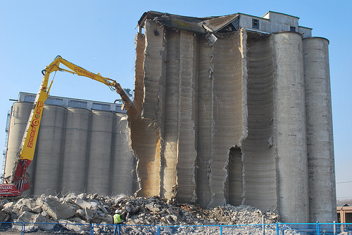
Breaking Down Silos
Notes:
Working across organizational boundaries

Slide 22
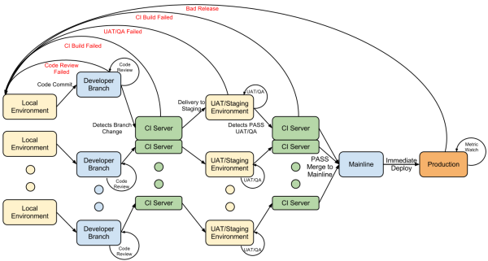
Continuous Integration/Continuous Deployment
Notes:
Automated software testing and deployment, possibly through to production.
NB: Not necessarily locally developed software, although that is where it is particularly useful, due to velocity.

Slide 23
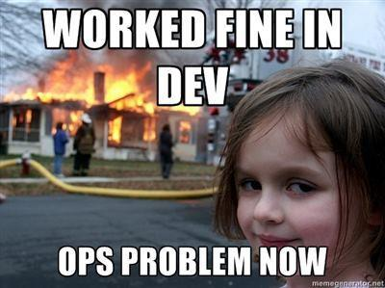
Developers Carry the Pager!

Slide 24
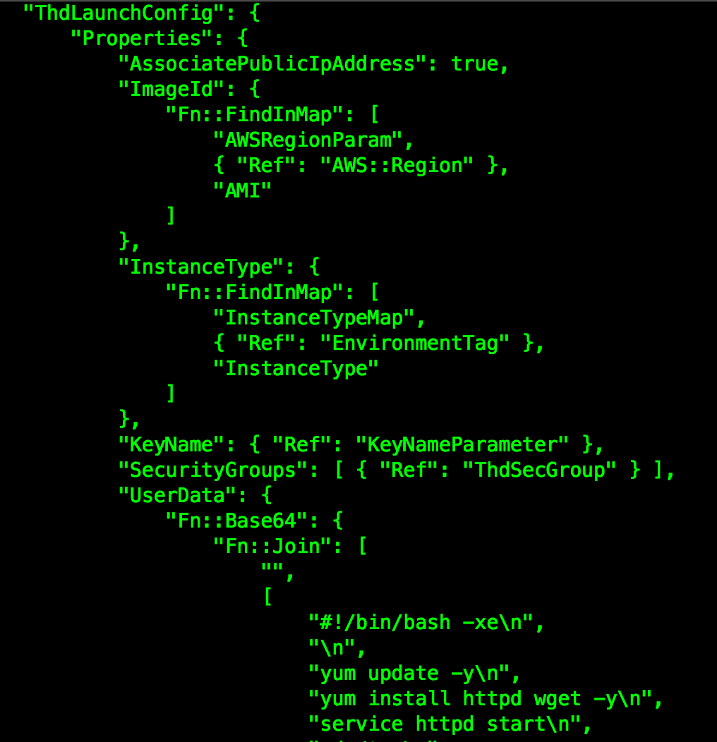
Infrastructure as Code

Slide 25
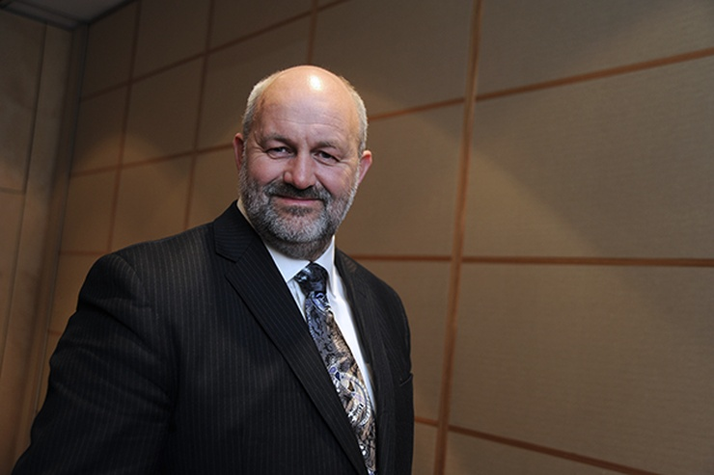
Everything Fails, All the Time
“…everything fails all the time. We lose whole datacenters! Those things happen…let us worry about those things, not you as a startup. Focus on your ideas.”
AWS CTO Werner Vogels
Notes:
Application designs must design for failure.
Pushing traditional operations into the cloud/platform

Slide 26


Pets vs. Cattle

Slide 27
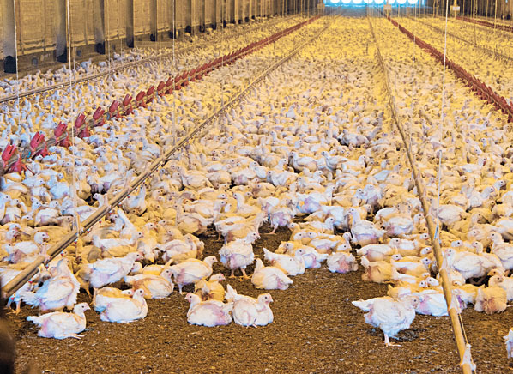
Pets vs. Cattle vs. Chickens

Slide 28
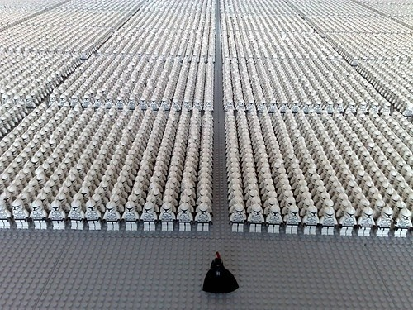
Immutable Infrastructure

Slide 29
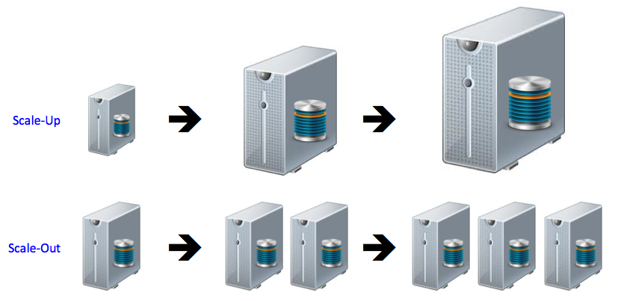
Scale Out and Stateless Compute

Slide 30
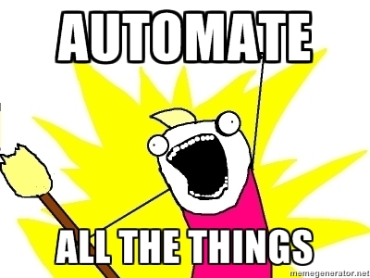
Automate All the Things!
Notes:
Able to do interesting new things with an API driven infrastructure.

Slide 31
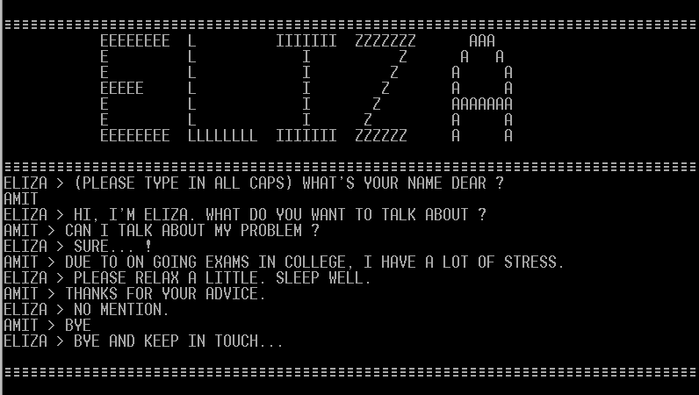
ChatOps

Slide 32
NoOps
NoOps == No Operations
Notes:
Not really a thing, Adrian Cockroft.

Slide 33
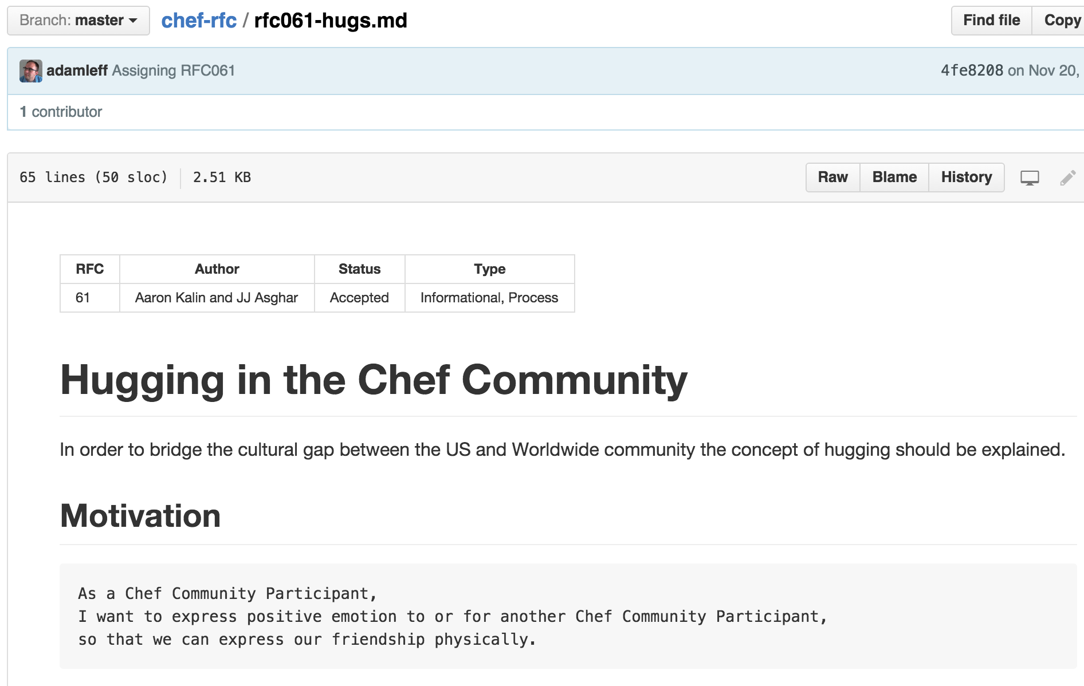
HugOps

Slide 34
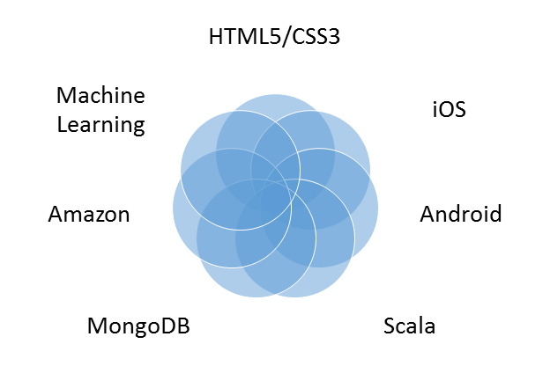
Full Stack Developers

Slide 35
How You Can Start

Slide 36
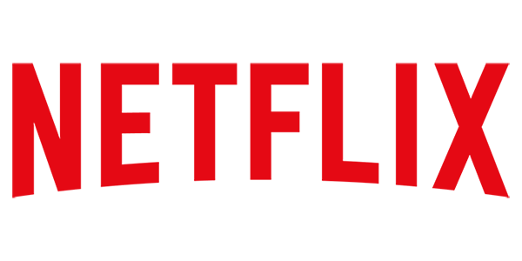


Follow Technical Blogs
Notes:
Things are changing quickly, follow technical blogs and/or twitter

Slide 37
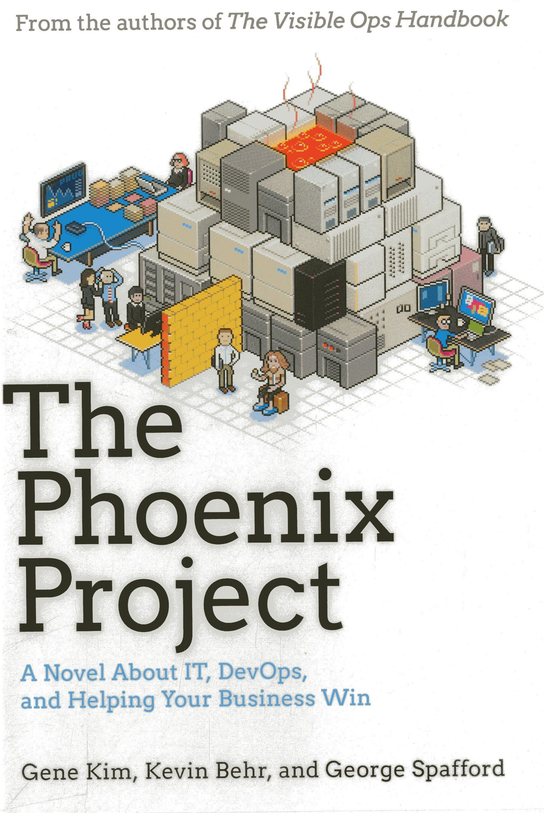
Read the Phoenix Project
Notes:
Based on the Goal by Eliyahu M. Goldratt.

Slide 38
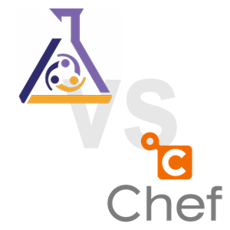
Learn Configuration Management
Notes:
You should be doing this anyway.

Slide 39
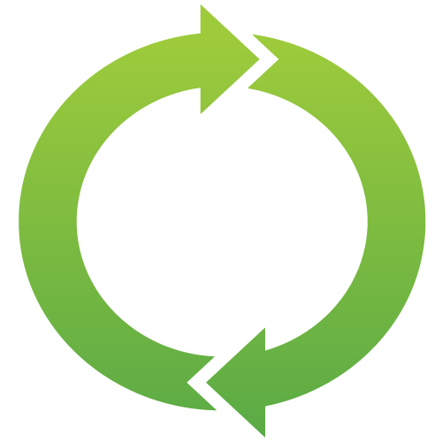
Learn to Program

Slide 40
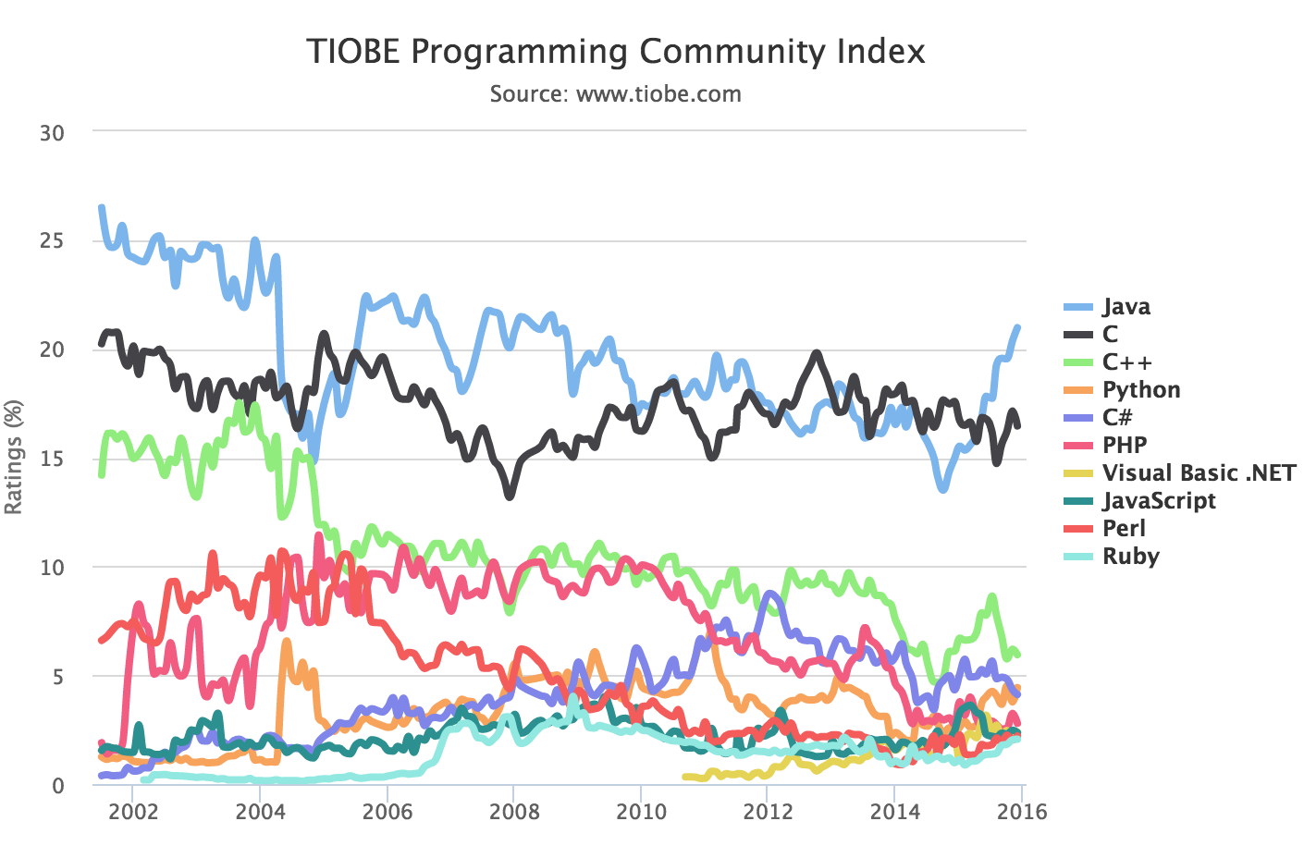
Learn to Program: Bash, Python and Java
Notes:
Python (and shell scripting) very common on infrastructure side, and lots of java build support.

Slide 41


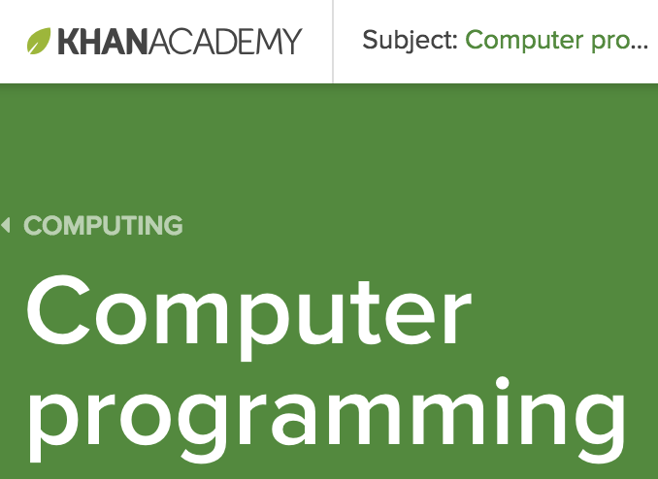


Learn to Program: Bash, Python and Java
Notes:
Python (and shell scripting) very common on infrastructure side, and lots of java build support.

Slide 42
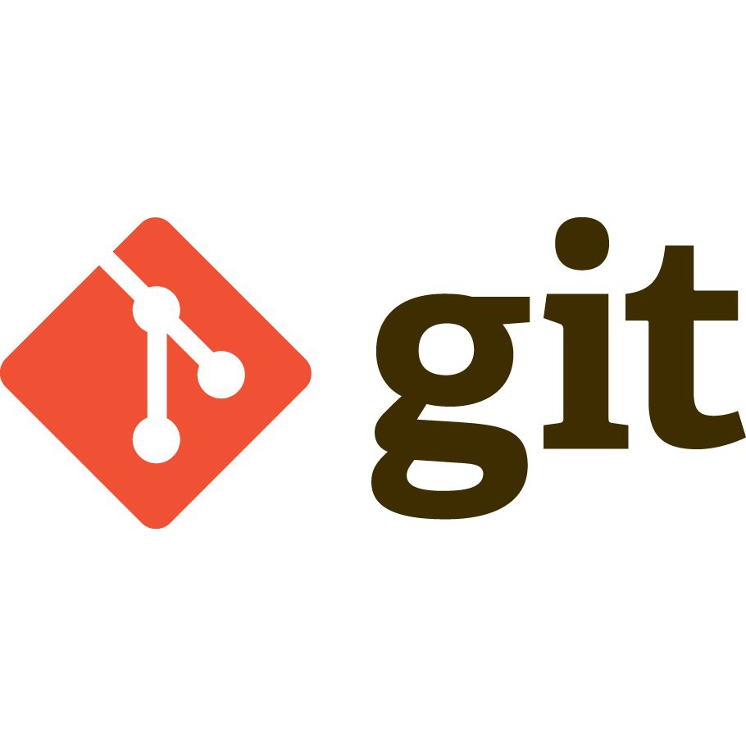
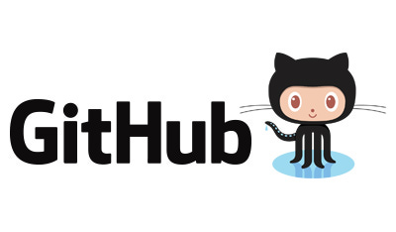
Use Git for Source Code Control

Slide 43
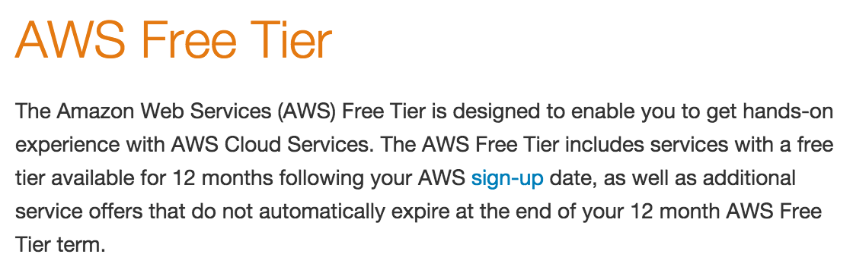
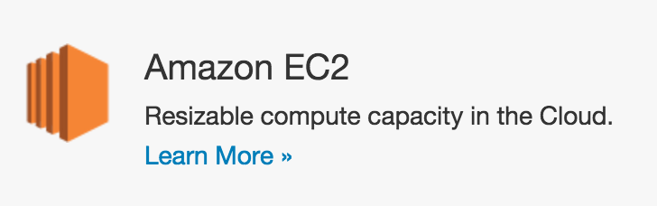
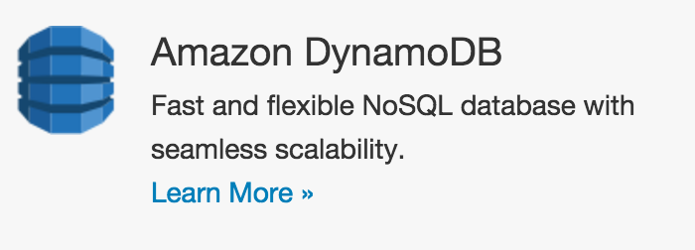
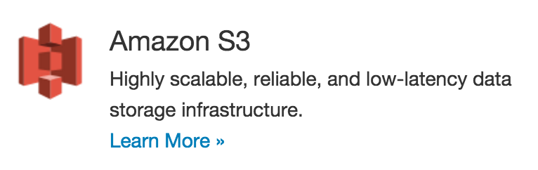
Learn AWS Using Free Tier

Slide 44
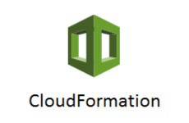
Learn AWS Using Free Tier

Slide 45

Automate Something Today

Slide 46
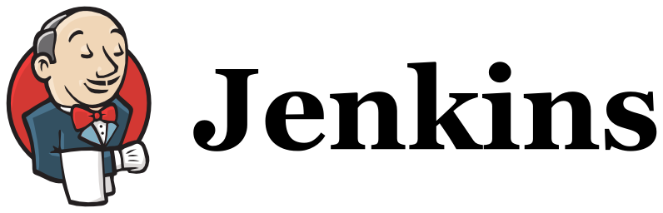
Publish via CI/CD

