Slide 1
GitLab Is For Admins, Too!
Ben Taylor R&D Systems Engineering, ORNL
taylorba@ornl.gov

Slide 2
This talk is not . . .
. . . a deep dive into GitLab.
. . . a sales pitch for GitLab.
. . . prescriptive in any way.

Slide 3
Outline
Collaboration Tools
Issue tracker
task management & documentation
Infrastructure management strategies
deploy keys
gitlab runners

Slide 4
Git + Lab = GitLab
version control software
online collaboration laboratory
Notes:
What is GitLab? Besides being a company in San Francisco, it’s a product that bundles together git, the open-source version control software created by Linus Torvalds, a set of tools that help you collaboratively create, version, test, and manage your work all via a web browser.

Slide 5
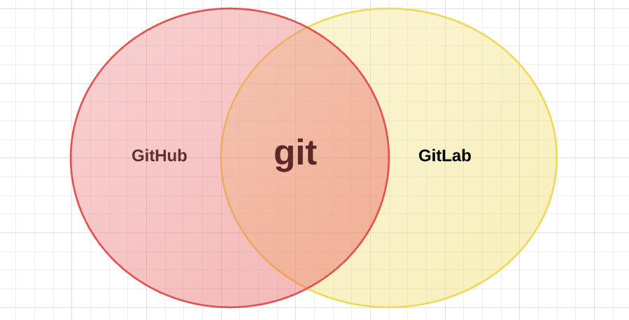
Notes:
You’ve probably heard of GitHub. It’s another company that does something similar. But this diagram is to try to convey the relationship between git, VCS, and some of its commercial implementations.

Slide 6
GitLab Collaboration Tools

Slide 7
GitLab Collaboration Features
Project Access Control
User Roles
Project Documentation & Management tools
Issue Tracking
Todos
Wiki
Services Integrations
Notes:
This isn’t meat of talk, but this has made GitLab stand out.

Slide 8
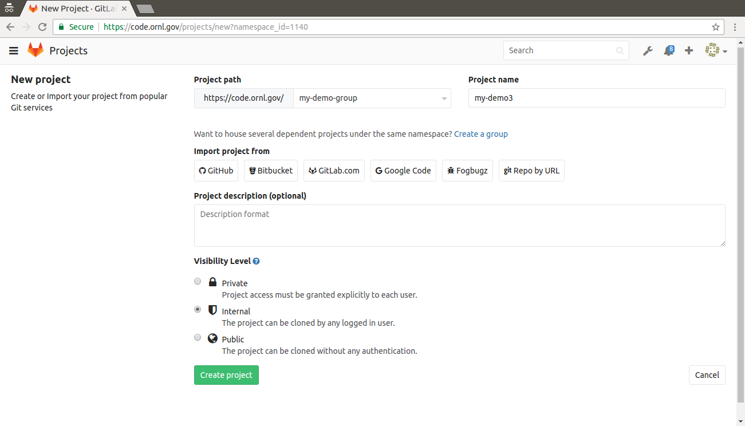
Project Access Control

Slide 9
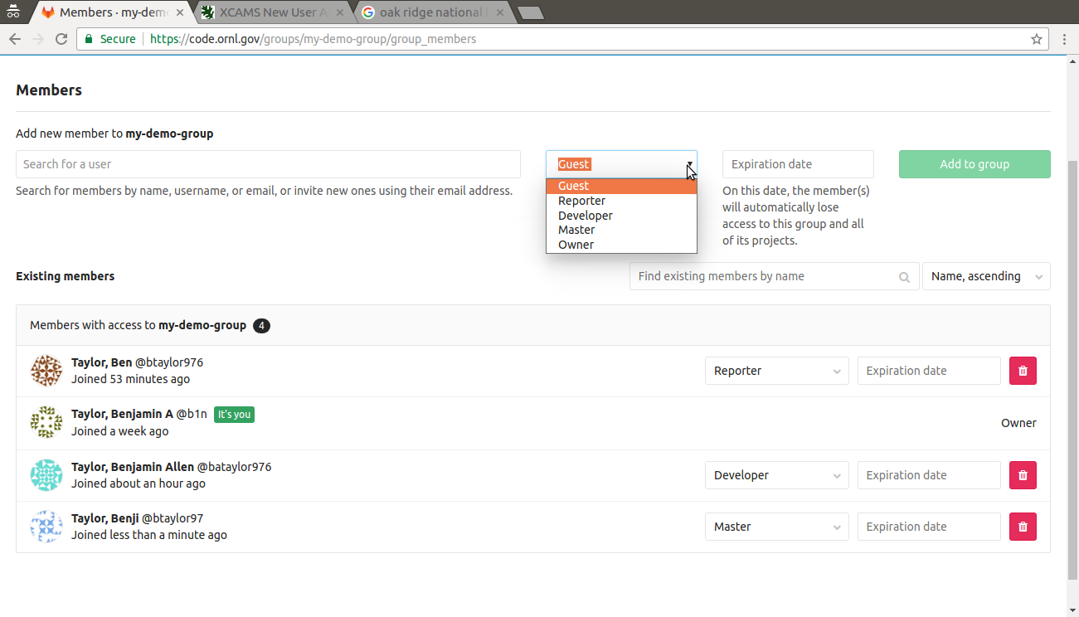
User Roles: Groups
Notes:
Can set permission levels for members in each group, that then apply to all projects within that group.

Slide 10
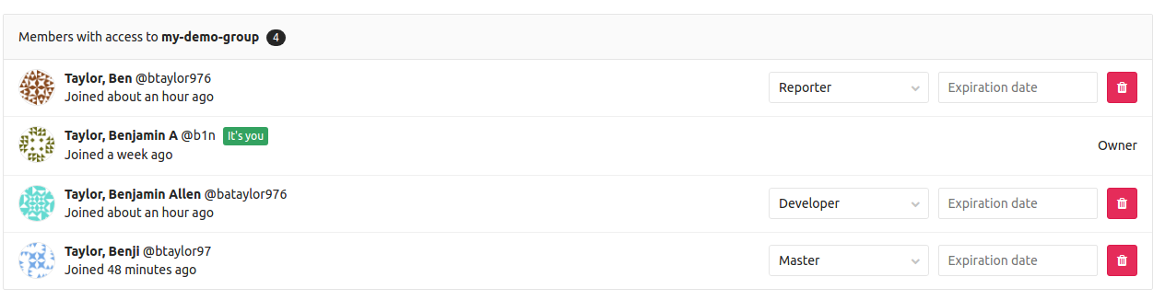
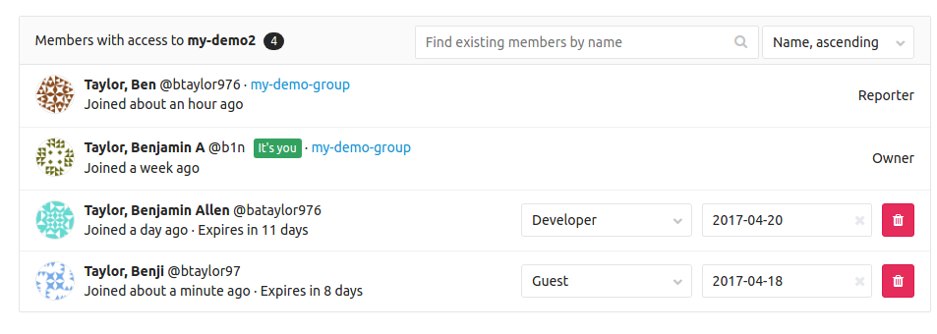
User Roles: Projects
Notes:
However, you can also change permissions levels on a per-project basis for more granularity of control.

Slide 11
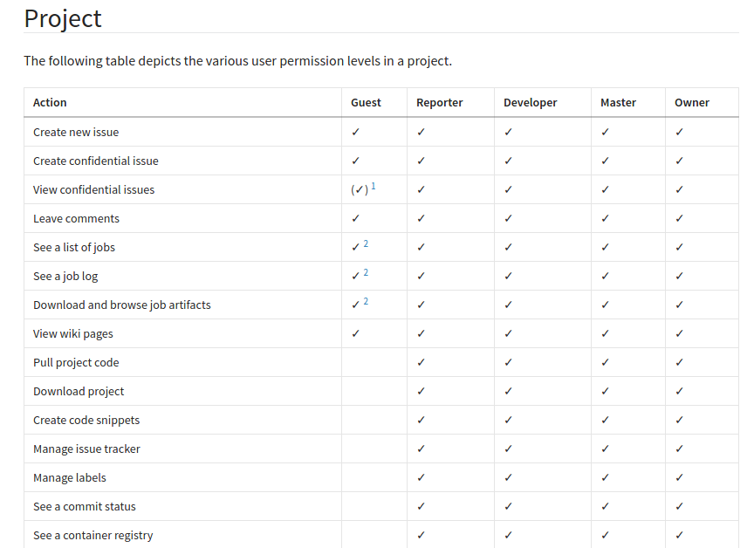
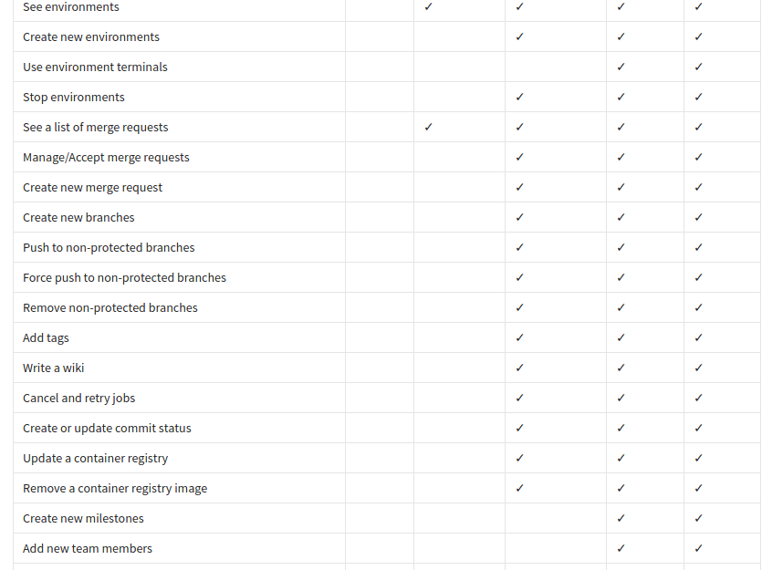
User Roles: Projects, cont’d

Slide 12
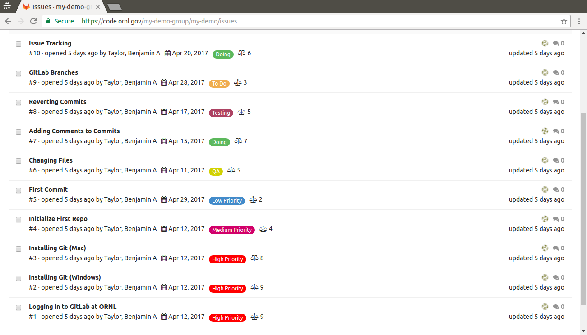
GitLab Issue Tracking
Notes:
GitLab folks like to speak of Software as a Discussion. An issue is anything that seems relevant to the project and that someone believes needs to be addressed. It could be problem, a suggestion for a different approach, a proposal for a new feature or service. Start with an issue, that is by searching the open issues, and if you can’t find your already listed, create an issue.

Slide 13
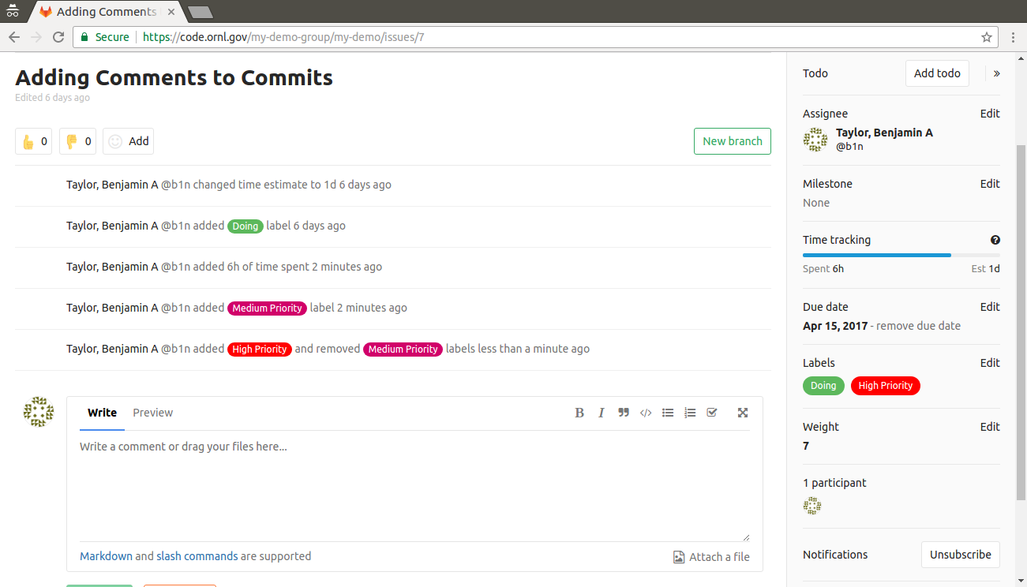
GitLab Issue Tracking, cont’d
Notes:
Sub-elements of issues include: assignee, time-tracking — offer time estimates, as well update time spent, labels for categorizing the features, relative weight of importance, for further prioritizing tasks, and number of participants. Issues can be updated with comments for further documentation.

Slide 14
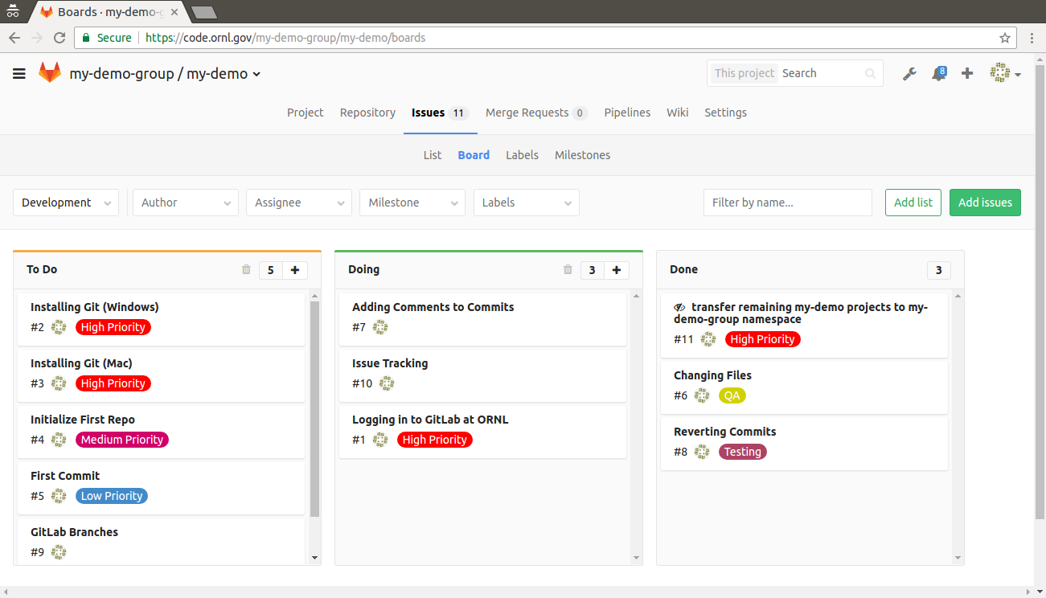
GitLab Issue Board
Notes:
The GitLab Issue Board is a software project management tool used to plan, organize, and visualize a workflow for a feature or product release. It can be seen like a light version of a Kanban or a Scrum board. It represents a different view for your issues. It can have multiple lists with each list consisting of issues represented by cards.

Slide 15
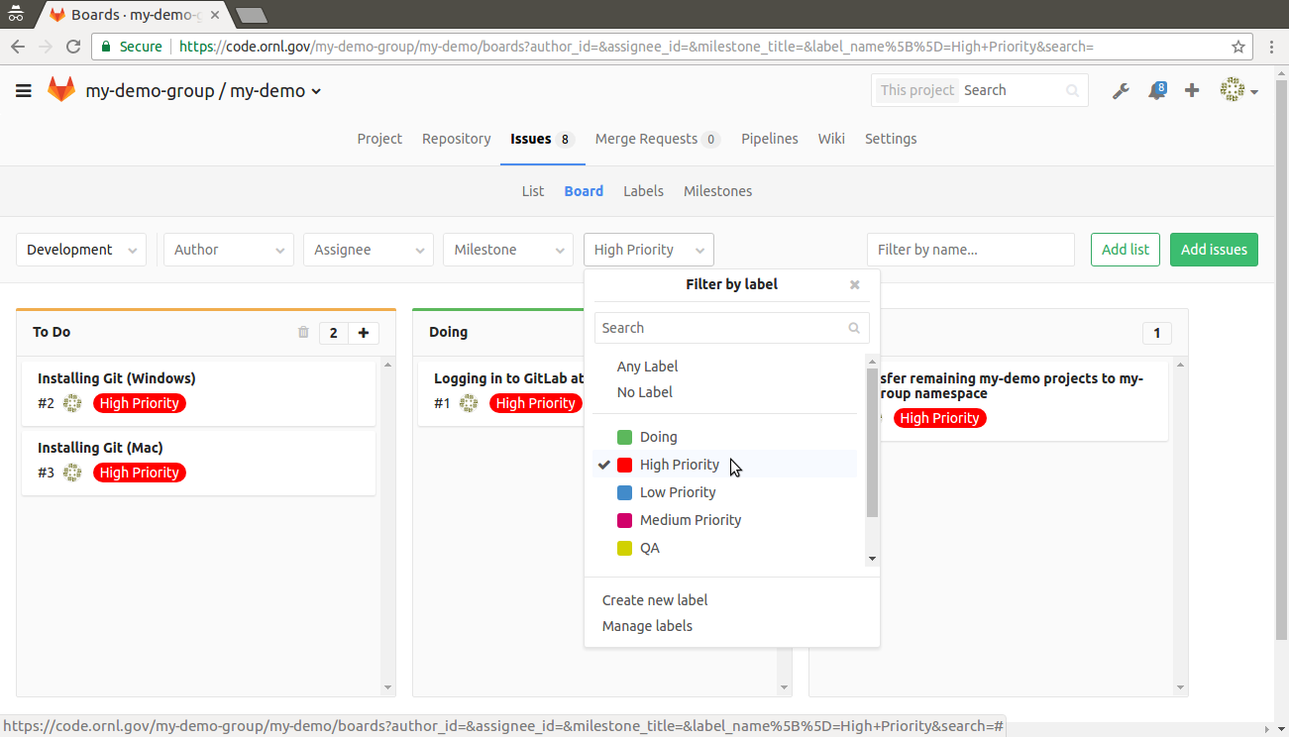
GitLab Issue Board: Label Filters
Notes:
hone in on what what the categories of issues you’d like to address.

Slide 16
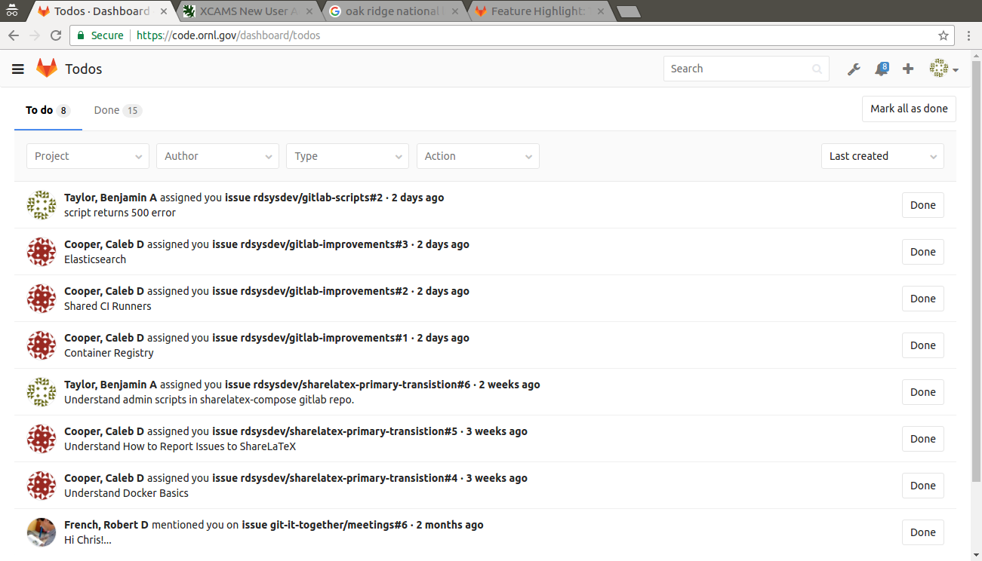
GitLab Todos
Notes:
Helps you see where you should spend your time and take some action, or what requires monitoring. Helps avoid piles of e-mail notifications. Todos is a chronological list of to-dos that are waiting for your input, all in a simple dashboard.

Slide 17
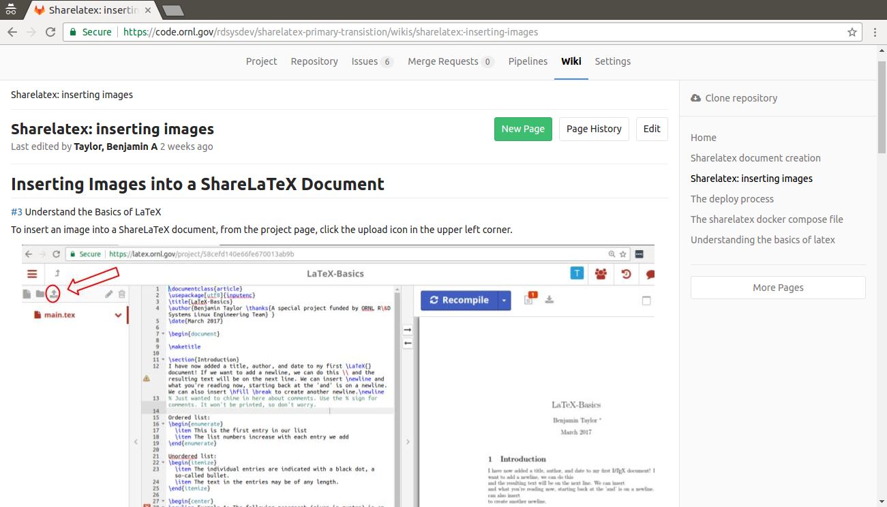
GitLab Wiki

Slide 18
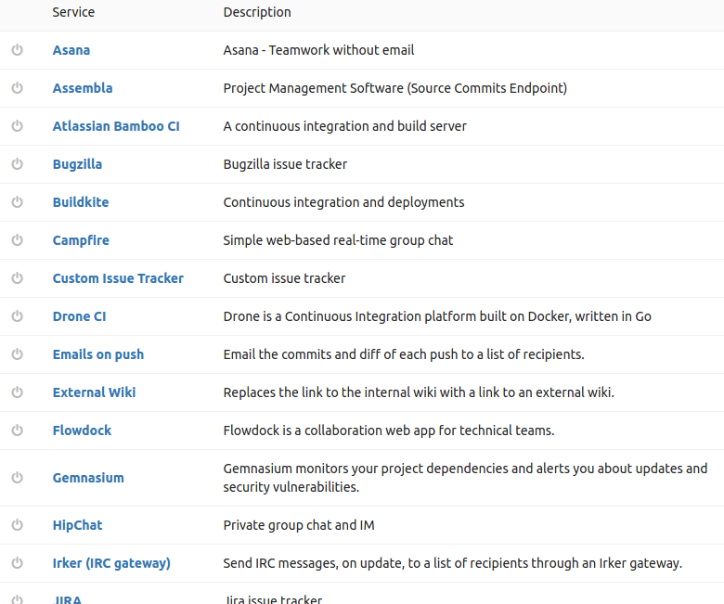
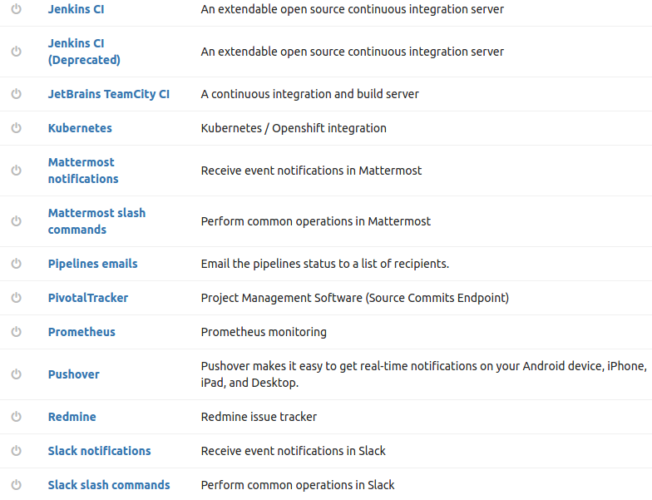
Services Integrations
Notes:
Project services allow you to integrate GitLab with other applications. They are a bit like plugins in that they allow a lot of freedom in adding functionality to GitLab.

Slide 19
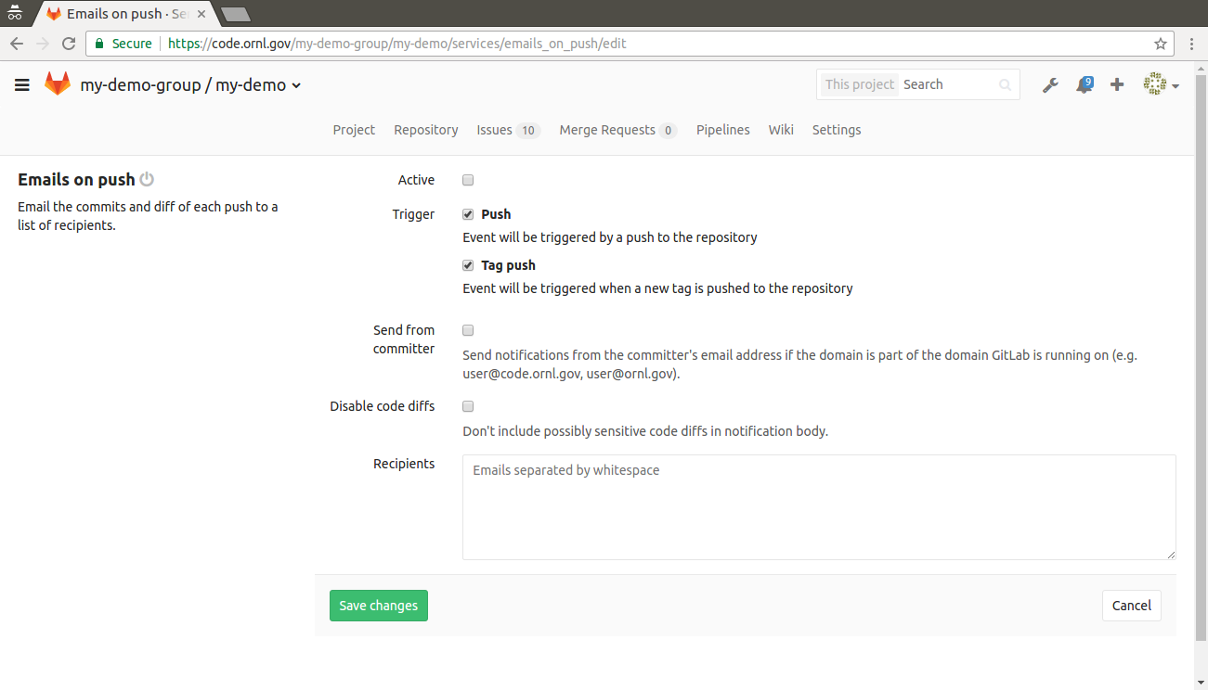
Email Notifications
Notes:
GitLab runners for monitoring your automation, and use it to build ad-hoc monitoring systems. (e.g., certificate checking).

Slide 20
Infrastructure Management Strategies

Slide 21
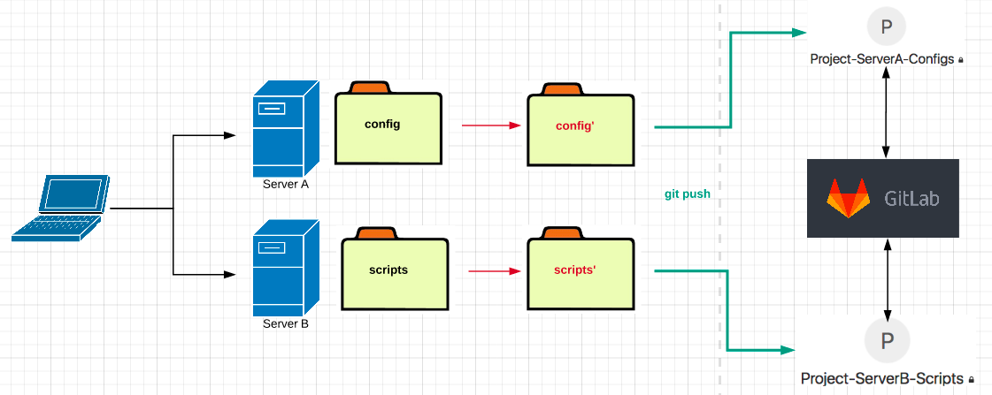
Simple: Remote File Backup
Notes:
It’s not wrong; it’s probably better than rsync’d tarballs, but why not reduce your interaction to just one system? What if someone forgets to commit a change?

Slide 22
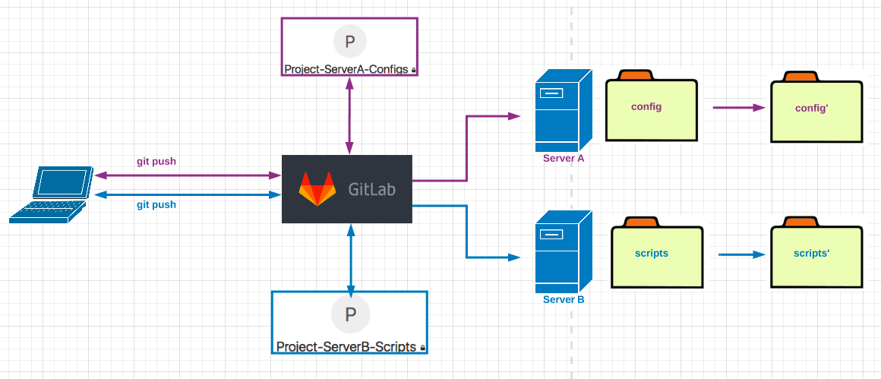
A Little Smarter: Basic “Config” Management

Slide 23
A Little Smarter: Basic “Config” Management
?
Notes:
But how do we manage this? How do GitLab and servers interact?

Slide 24
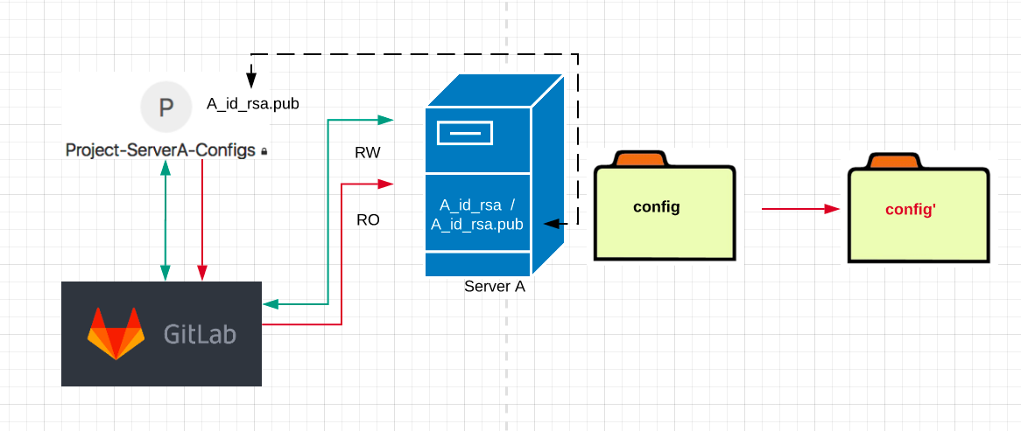
Deploy Keys
Example: RO cronjob
#*/10 * * * * ./path/to/git-pull-script
Notes:
Assign ssh to projects rather than people.

Slide 25
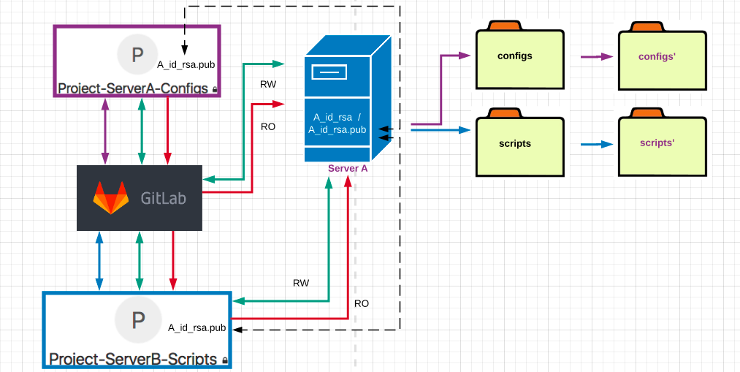
Deploy Keys: Multiple Projects

Slide 26
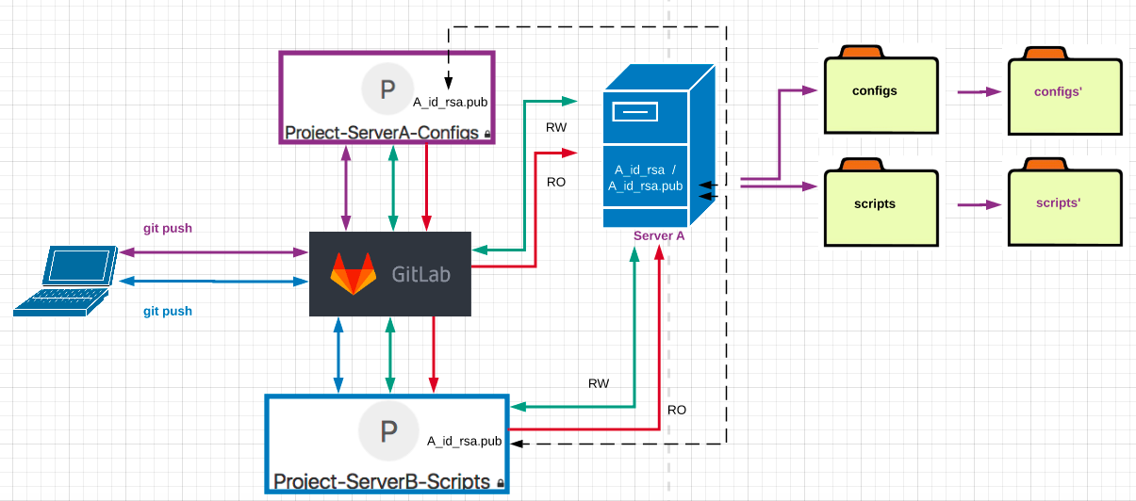
Deploy Keys: Multiple Projects
Notes:
But how do you know when you do a git pull. And what if you want to do new stuff? Like stop the service, and add some new stuff. You could write something that would check, etc.

Slide 27
Deploy Keys: Multiple Projects
success?
more?
Notes:
But how do you know if this has been successful? What if you want to do more? And if it fails, where and how?

Slide 28
Automating Deployments with GitLab Runner
Notes:
(of configs)

Slide 29
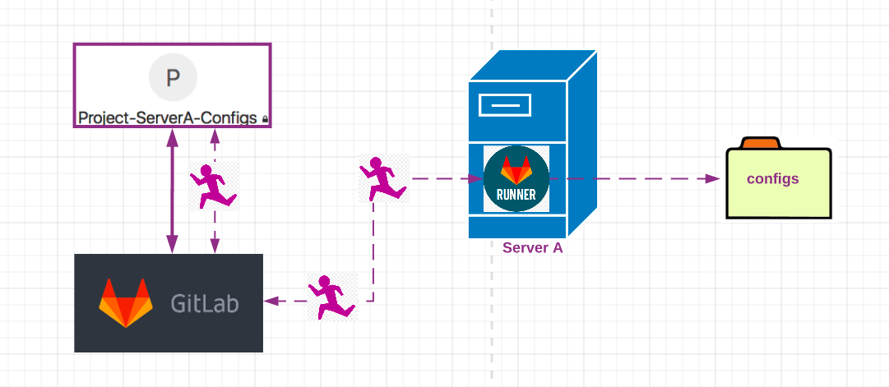
GitLab Runner
tFigur9nNfAelxVhBS6C
tFigur9nNfAelxVhBS6C
tFigur9nNfAelxVhBS6C

Slide 30
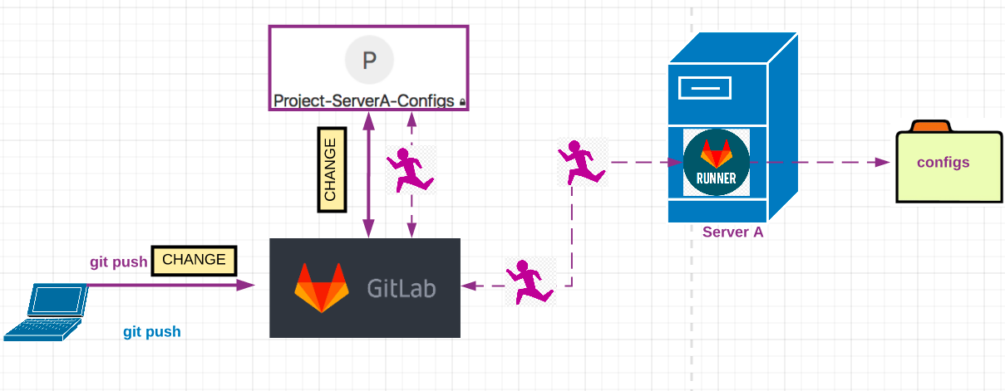
GitLab Runner
pgs729rXlnwk3R2v
pgs729rXlnwk3R2v

Slide 31
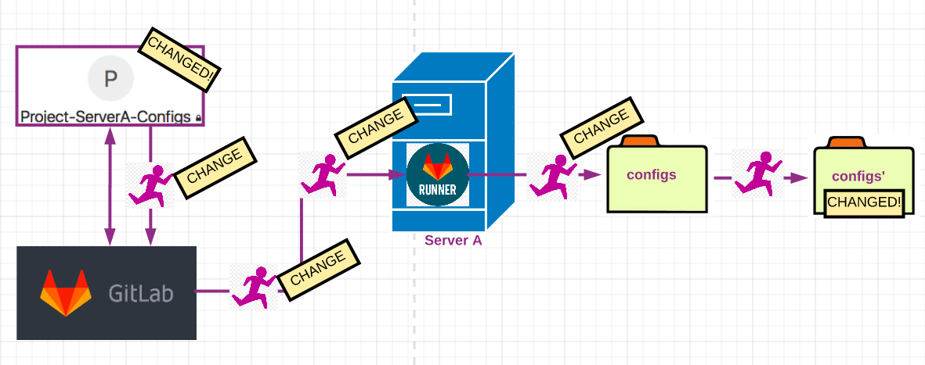
GitLab Runner

Slide 32
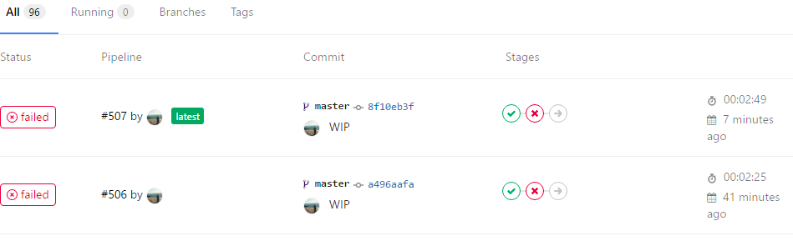
GitLab Runner: Real-Time Monitoring & Feedback

Slide 33
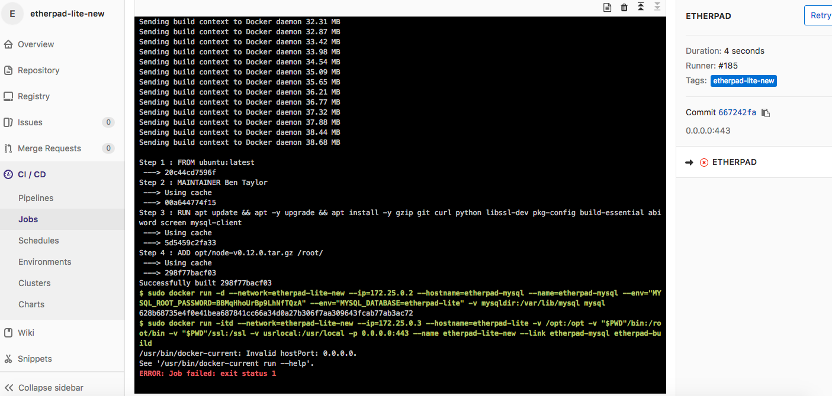

Slide 34
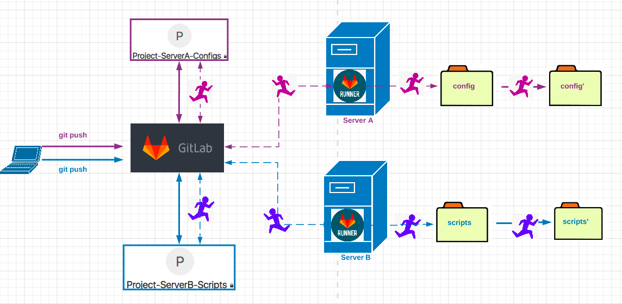
GitLab Runner: Multiple Projects
tFigur9nNfAelxVhBS6C
tFigur9nNfAelxVhBS6C
pgs729rXlnwk3R2v
pgs729rXlnwk3R2v

Slide 35
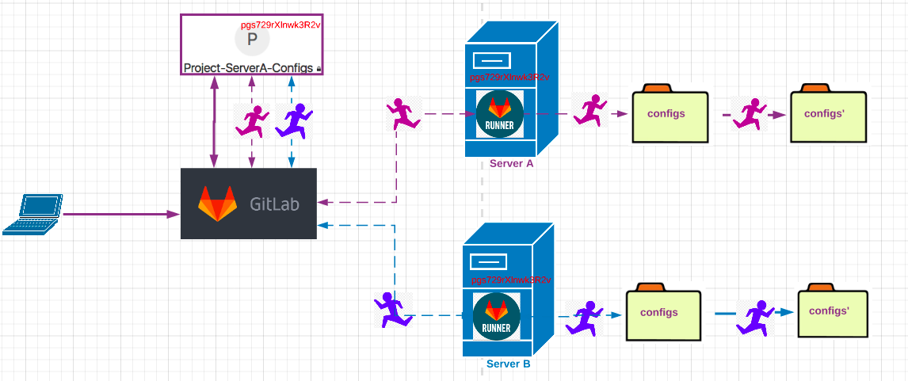
GitLab Runner: Single Project, Multiple Runners

Slide 36
GitLab Runner: Jobs, Pipelines, Artifacts
Job: An action performed by a GitLab Runner (copy files, run a script, compile, etc.)
Pipeline: a series of jobs (sequential or in parallel)
Artifacts: pipeline product or output (executable binary, zipped file, text file, etc.)
Tags: Given to a runner giving it conditions for action.

Slide 37
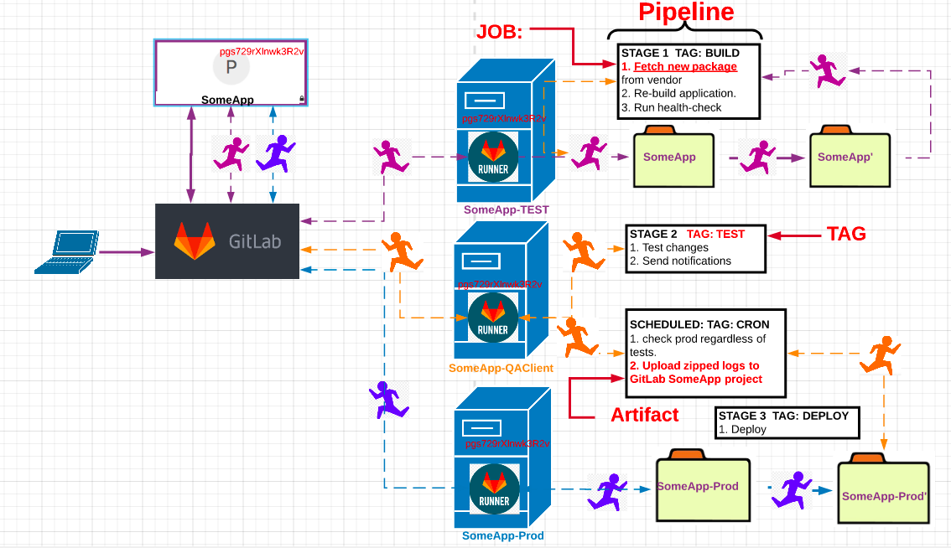

Slide 38
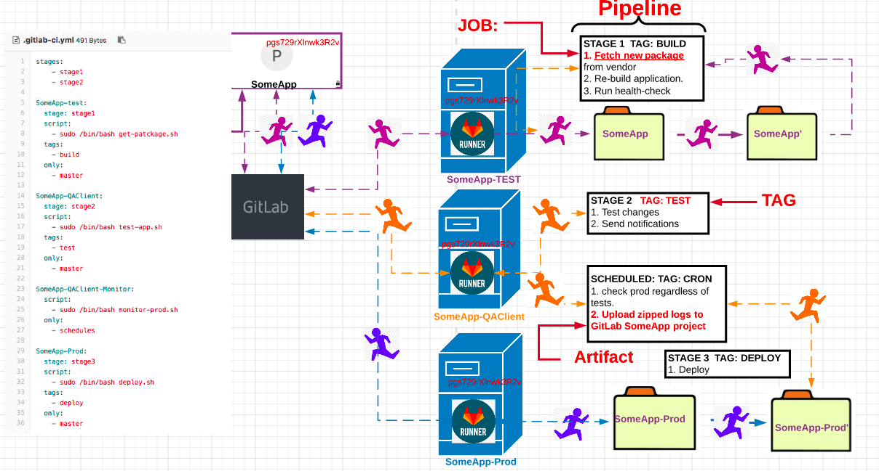

Slide 39
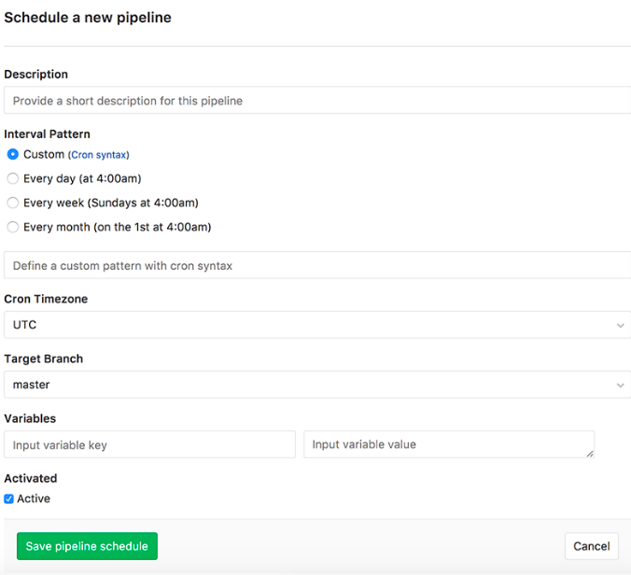
GitLab Runner: Scheduled Pipeline Example

Slide 40
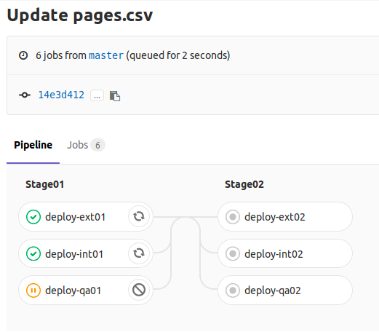
Pipeline Graph: Disrupted Pipeline Example

Slide 41
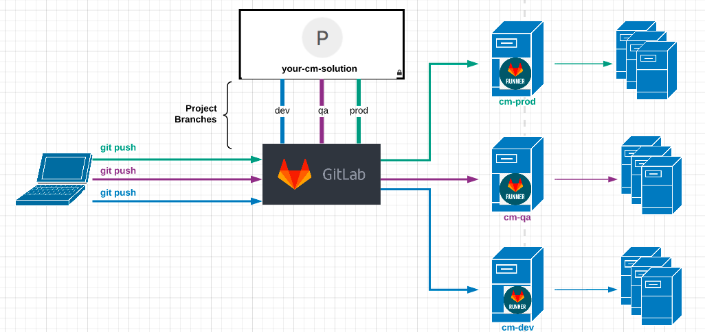
GitLab Runner: Infrastructure Orchestration
Notes:
Augmenting your infrastructure orchestration

Slide 42
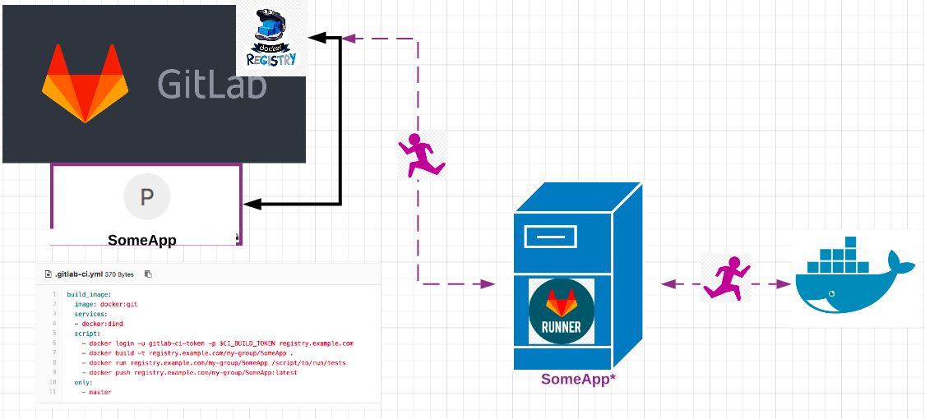
GitLab Docker Container Registry

Slide 43
Takeaways
GitLab as the primary point of interaction with your systems.
Use GitLab to track all changes that are made to your configurations.
Automate deployments and other operational tasks through runners.
Orchestrate multiple systems as jobs in pipelines.

Slide 44
How To Get Started
Deploy GitLab.
Version control your configs and scripts.
Automate through CI Runners.
???
Profit!

Slide 45
Thank You!

Slide 46
GitLab Licensing
Licensing Model: open core
Community Edition (CE) — free
Open source
MIT Expat License
Enterprise Edition (EE) — subscription
Built on top of CE, with additional proprietary features
Various package options
Products & Services
Hosted SaaS — GitLab.com (see about.gitlab.com/gitlab-com/)
Self-hosted — (see about.gitlab.com/products/) (focus of this talk)
Notes:
GitLab is built on an open core model. That means there are two versions of GitLab: Community Edition and Enterprise Edition.
GitLab Community Edition is open source, with an MIT Expat license. GitLab Enterprise Edition is built on top of Community Edition: it uses the same core, but adds additional features and functionality on top of that. This is under a proprietary license.
For both versions: All javascript code in GitLab is open source. All javascript code written by GitLab is under the same MIT license.
GitLab is built on an open core model. That means there are two versions of GitLab: Community Edition and Enterprise Edition. GitLab Community Edition is open source, with an MIT Expat license. GitLab Enterprise Edition is built on top of Community Edition: it uses the same core, but adds additional features and functionality on top of that. This is under a proprietary license. For both versions: All javascript code in GitLab is open source. All javascript code written by GitLab is under the same MIT license.

