Slide 1
Code Writing Code, say what now!

Slide 2

Write “HELLO!”
I’m Wesley Kirkland
I have over 3 years of Systems Engineering experience consisting of On Premise, Cloud, and automation. Currently I work at Ministry Brands as a Sr. Systems Engineer working with AWS/Azure and Office 365.
Notes:
I love interactive collaboration while speaking, it’s highly encouraged and it makes everything more fun!
Now there is a special reason for this presentation. This talk got accepted at the 2018 PowerShell summit, I would love feedback on this and ideas for future projects. This presentation is still a work in progress for the Summit,
And yes I have to show my AWS love here
The secret is that the best engineers are lazy. They love automation & will spend days to automate something.” - Jeffrey Snover

Slide 3
Meta Programming is the writing of computer programs that write or manipulate other programs (or themselves) as their data
Notes:
Before we continue, I should mention that most of Google points Java and C++.
Now what does this mean?
This sounds complicated, though it’s really not when we break it down
Let’s think of some example use cases.
SQL Queries - Hopefully everyone in this room has written SQL queries in another language and then executed them.
This qualifies for the other programs data becoming itself
Writing simple templates to fill in
Think of like a word template or excel template document
Writing in a different language in one source language
Write an entire framework of a function in seconds

Slide 4
An extension
At the core Meta Programming is simple
It’s a technique and not a language
  Reflection
  Template
The program can adapt and modify itself on the fly
Notes:
Metaprogramming is technique and not a language nor a defined way of doing something.
For example in a traditional program your program is evaluated at run time and is fairly static throughout.
With Meta Programming your program adapts to varying conditions throughout execution
Techniques - 2 very popular ones
Reflection - Allows your program to adapt to changes in the environment during execution
Template - Form of meta programming where the compiler generate temporary source and then compiles it
For our purposes we’re going to forgo these techniques, were going to focus on Metaprogramming at it’s core.
Keep in mind Meta Programming at it’s core is for the program to adapt/manipulate itself

Slide 5
Pros
$TRUE
More Expressive
Consistency
Productivity
Less Code
Notes:
More Expressive - Less code to write and maintain
Think about it like this, your code can change very drastically based upon the environment, or based upon the function that it is performing
This can allow your code to become incredibly flexible
Consistency - Consistent behavior over the array of problems you're solving
Your code will always produce a similar result set
Productivity
You can adapt your code to new functions with only adding a few lines of code
Adding new function doesn’t take that much time
Less Code
Less code overall
The code you have can be far more complex code if you do it wrong

Slide 6
Cons
$FALSE
Complexity
Safety
Bugs
Time Investment
Notes:
Complexity
Far more complex and harder to read, even with significantly less code
Safety - Static Analysis (Reading through the code without running it) is not possible
You can’t always check your code without execution of your code
Casting is not always possible due to different data types
Best practices are sometimes ignored
Bugs
Small typos and errors can have a massive impact!
For example you missed a parenthesis but your code doesn’t always run that section, you may not notice the error except under very specific conditions.
Replicating these specific conditions can require significant work, especially when your code is many layers deep
Debugging is much easier if your code outputs the generated code
Time Investment
Writing the initial code for meta programming can require significant time investments
As well as debugging can require lots of time

Slide 7
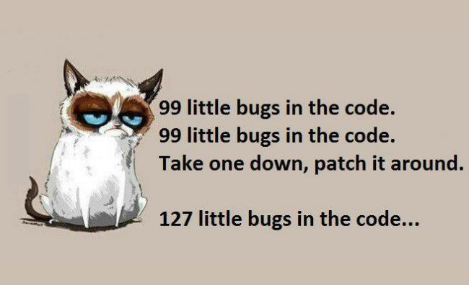
Notes:
I want to go back and talk about the bugs again, if you do it wrong (and your will at first) you will have tons of bugs.
Example of my missing switch statement which nuked my DB, with the cascading effects of foreign keys

Slide 8
You’re already doing this
SQL Queries
Basic Code Generation
Windows
  System Center Products
Notes:
Believe it or not you have already done Meta Programming in the most sense and may not have realized it.
Remember those SQL queries that you generated? Your insert statements are really good examples of this
Basic code generation
Or that crazy string you generated to feed to a batch application?
Microsoft even does this for you
Have you ever noticed the “View Script” button in SCVMM or another system center product?

Slide 9
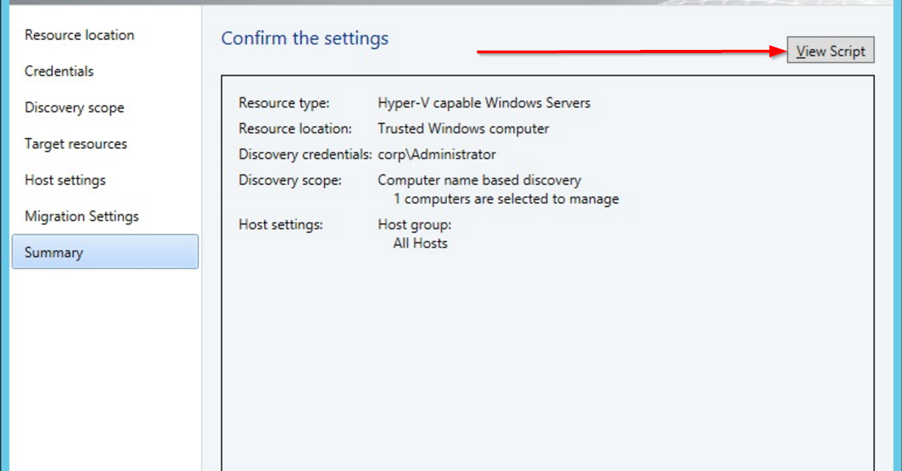
Notes:
SCVMM example of view script

Slide 10
Candidacy
Repeating Patterns
Tricky Code
Minor Variations
Anticipated Changes
Notes:
Repeating Patterns
Excellent candidacy when your code is repeating
The same base code is used for multiple situations
Tricky Code
When your code requires logic to fill out some parameters, for example matching event ids
Minor Variations
Parameters are reordered or properties are changed
Anticipated Changes
Architecture changes can easily be modified
Non-Scaffolding Code

Slide 11
Things to Consider
Character Escaping
Indenting
Spacing
Comments
Complete Code
Output Methods
Notes:
Now that we have covered a few basics I want to point out a few things
Character Escaping
If you use methods like .Net string replacement you can run into issues with character escaping
Single quotes
Parentheses
When to use single quotes and when to use double quotes
Single Quotes around your scriptblock are typically easier
Unless you need to run code inside of your scriptblock
Indenting
NOTE: Show Indenting Example
Measured in spaces, sorry Tab Nazis (Myself Included)
Proper Indenting in your source
Source Code will look perfect
Generated code will look like garbage - Take those pre generated xml files that are all on 1 line
Proper Indenting in your generated code
Source code will look like garbage
Generated code will look perfect
Accounting for this requires some unique tricks in your source code
Script Blocks
Scripts Blocks are a good way for you to write your code but can produce some odd issues
Your code runs in the script block
Indenting will be off
Your script block can not be indented properly along with you code - VS Code
Spacing - Just a thought consideration
Normally when you're writing everything is spaced correctly
No double spaces
No random lines
Comments
Injecting comments - You have to use methods that don’t treat your comments in the current script if you want them to be outputted
Runnable script blocks will cause your comments to appear in the main script
String Replacement and Single quotes allow you to inject comments in the output
You should always comment your code, especially when your meta programming
Complete Code
When running tests you need to execute all of your code so it fully generates
NOTE: Show Completed Code Example
Simply looking at your code will not work in most cases - Static Analysis
NOTE - Show the Binary Function Generation
Output Methods
NOTE: Show Output Methods example
Arrays
For small projects (Less than ~1000 lines you can easily add to an array)
Pros
Easy to use for quick and dirty work
Higher Memory Usage
ArrayList
For medium projects, I would suggest adding your code to an arraylist for faster addition
Pros
Higher Memory Usage
Low latency
No external dependencies
Arraylist with VOID
We are typecasting our code to say no output will be returned
Same as above but it not piping out data
File
For large projects you can output directly to the file system
Pros
Large amounts of code
You can tail your code for debugging
Can be easily integrated into source control
Databases
For projects that require lots of logging and for code to be viewable by different people/programs
Pros
Useful for historical logging
Very reliant upon several external dependencies

Slide 12
Other Demos /Examples
Notes:
Unit Test Generation
Invoke-ConsoleApplicationWrapper
Example of Meta Programming at RunTime
Invoke-BinaryFunctionGeneration
Example of Meta Programing Static Code generation

Slide 13
Get-Contact
Github: https://github.com/wesleykirkland
Email: wesley@wesleyk.me
Web: wesleyk.me
Linkedin: WesleyKirkland
Twitter: @UnleashTheCloud
All of these examples can be found below
https://github.com/wesleykirkland/Summit2018

