Slide 1


Slide 2
Terraform: Everything as Code

Slide 3

Andy Cowell has over twenty years of system administration experience in a variety of environments. Currently, he works for Discovery, Inc., as the manager of the Application Engineering and Automation group in Cloud Infrastructure.
He has been responsible for some of the top
destinations on the Internet, such as HGTV.com, Dilbert.com, and Metallica.com. In the past, he has worn many hats, from networking admin to full-time developer, and cut his teeth as a "Wizard" with the UTK Computer Science department.
When not wrangling systems, he solders microcontrollers, paints toy soldiers, drinks bourbon, smokes pipes, watches hockey, grows algae, and rolls 20s.
email: andy@cowell.org

Slide 4
Infrastructure as Code
One of the great promises of the cloud

Slide 5


Slide 6
Traditional Physical Infrastructure
Long lead time
  90 days to receive
  Multiple teams must touch to install
Inflexible configuration
  Hope your requirements were correct
  And didn’t change in the meantime
Three year depreciation
  May not even get a new server
Physical, manual installation

Slide 7
Modern Cloud Infrastructure
No lead time
  Near immediate service
  One touch installation
Flexible configuration
  Try something out
  Change it to something better
No reason to keep if not using it
  Get the same new server over and over
APIs for everything

Slide 8
Modern Cloud Infrastructure, continued
We’ve had automation before, creating things like configuration management.
The cloud has brought APIs to traditional infrastructures items that were difficult to automate, such as networking devices.
In addition, the cloud has increased segmentation between infrastructure segments

Slide 9
Modern Cloud Infrastructure, continued
Segmentation: lowered blast radius
Lowered blast radius: end user access to infrastructure
End user access to infrastructure coupled with APIs: Infrastructure as code for you and me!
(If only the admins have it, who really cares?)

Slide 10
Infrastructure as code...is the process of managing and provisioning computer data centers through machine-readable definition files, rather than physical hardware configuration or interactive configuration tools

Slide 11
Example
resource "aws_instance" "example1" {
ami = "ami-0b425589c7bb7663d"
instance_type = "t2.micro"
}

Slide 12
Terraform
The Infrastructure as Code solution from HashiCorp

Slide 13
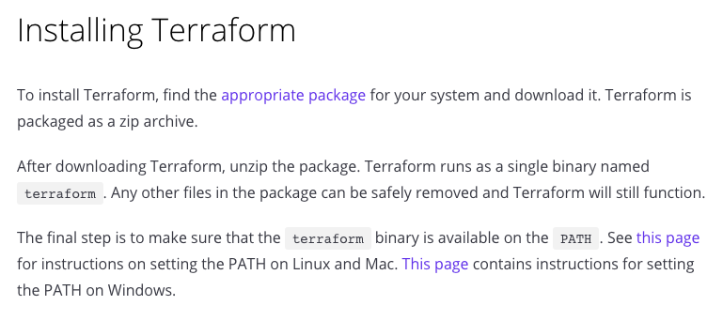

Slide 14
Terraform Workflow
Create or make changes to template and workspace (template now does not match reality)
Plan our changes (ask Terraform to show us exactly what changes to reality it is going to make)
Confirm that this matches our expectations (If not, go back to step 1)
Implement changes (let Terraform make the changes we confirmed)

Slide 15
Terraform Example
andy@shoggoth:terraform$ cat ec2-base.tf
resource "aws_instance" "example1" {
ami = "ami-0b425589c7bb7663d"
instance_type = "t2.micro"
}

Slide 16
Terraform Example
andy@shoggoth:terraform$ terraform plan
Plugin reinitialization required. Please run "terraform init".
Reason: Could not satisfy plugin requirements.
Plugins are external binaries that Terraform uses to access and manipulate
resources. The configuration provided requires plugins which can't be located,
don't satisfy the version constraints, or are otherwise incompatible.
1 error(s) occurred:
:

Slide 17
Terraform Example
andy@shoggoth:terraform$ terraform plan
Plugin reinitialization required. Please run "terraform init".
Reason: Could not satisfy plugin requirements.
Plugins are external binaries that Terraform uses to access and manipulate
resources. The configuration provided requires plugins which can't be located,
don't satisfy the version constraints, or are otherwise incompatible.
1 error(s) occurred:
:

Slide 18
Terraform Example
:
* provider.aws: no suitable version installed
version requirements: "(any version)"
versions installed: none
Terraform automatically discovers provider requirements from your
configuration, including providers used in child modules. To see the
requirements and constraints from each module, run "terraform providers".
:

Slide 19
Terraform Example
andy@shoggoth:terraform$ terraform providers
.
└── provider.aws
andy@shoggoth:terraform$

Slide 20
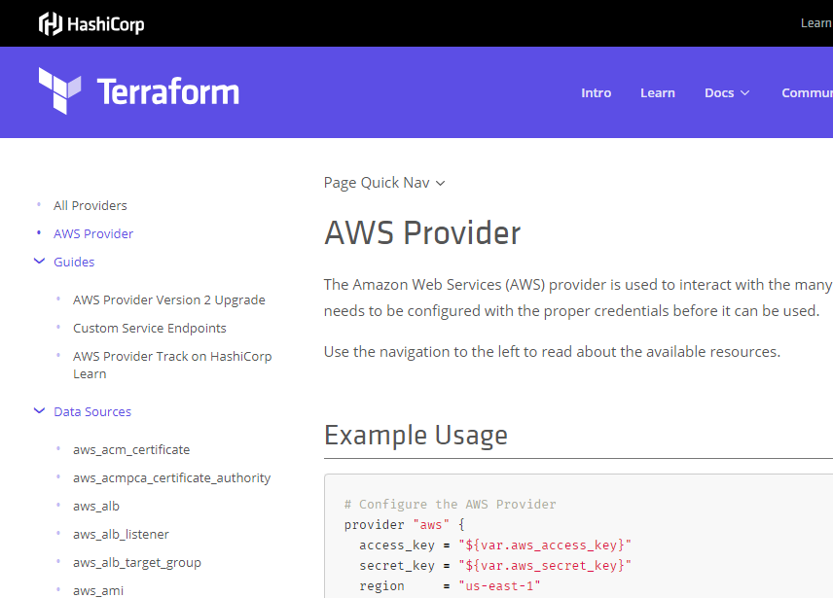

Slide 21
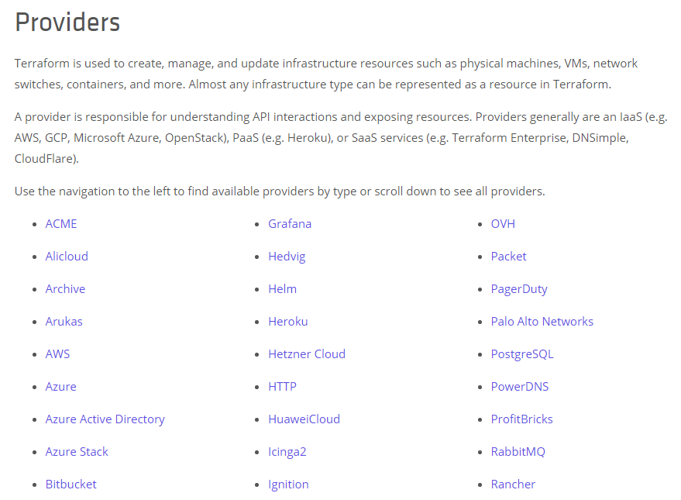

Slide 22
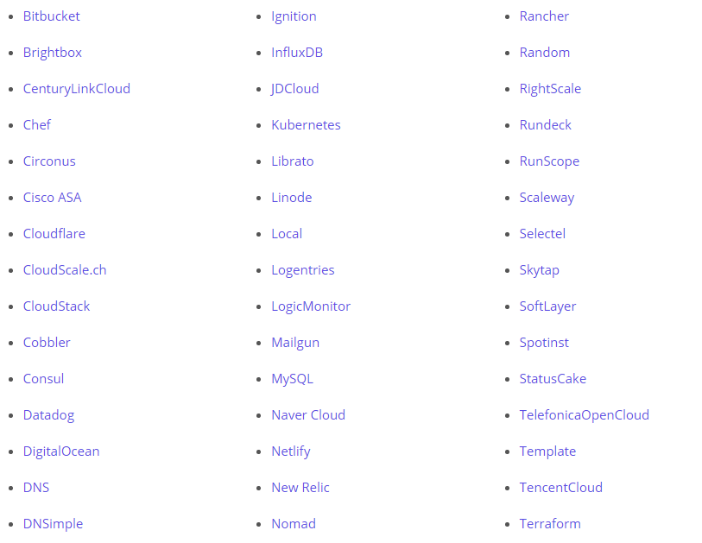

Slide 23
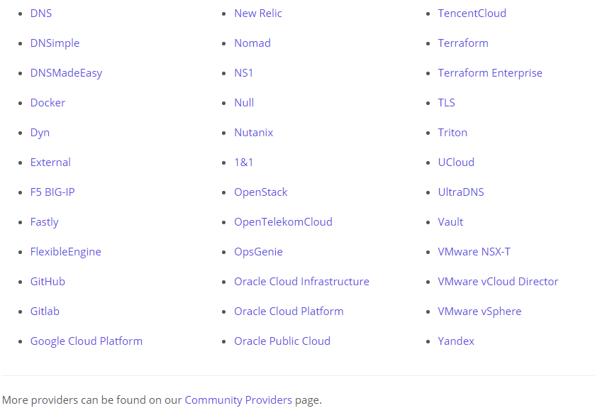

Slide 24
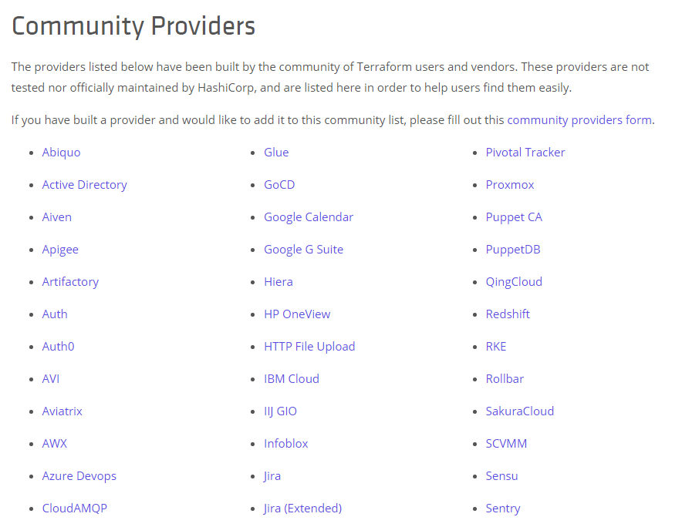

Slide 25
Terraform Providers
What is a good candidate for a Terraform Provider?
It must have an API
End user must be able to set state
End user must be able to query state

Slide 26
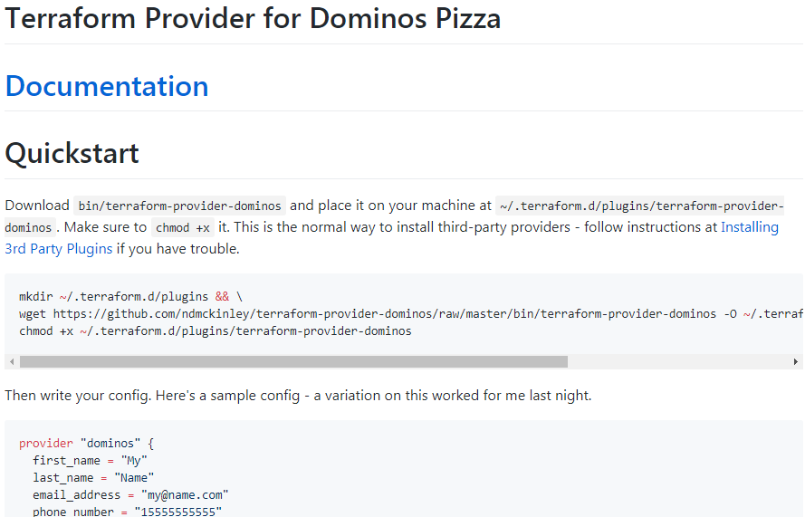

Slide 27
Terraform Providers
What is a good candidate for a Terraform Provider?
It must have an API
End user must be able to set state
End user must be able to query state
Non-functional requirement: workload shouldn’t change state in a desired manner on its own (we want to manage state changes)

Slide 28
Terraform Example, continued
andy@shoggoth:terraform$ terraform init
Initializing provider plugins...
- Checking for available provider plugins on https://releases.hashicorp.com...
- Downloading plugin for provider "aws" (2.5.0)...
The following providers do not have any version constraints in configuration,
so the latest version was installed.
:

Slide 29
Terraform Example
:
To prevent automatic upgrades to new major versions that may contain breaking changes, it is recommended to add version = "..." constraints to the
corresponding provider blocks in configuration, with the constraint strings
suggested below.
* provider.aws: version = "~> 2.5"
Terraform has been successfully initialized!
:

Slide 30
Terraform Example
:
You may now begin working with Terraform. Try running "terraform plan" to see any changes that are required for your infrastructure. All Terraform commands
should now work.
If you ever set or change modules or backend configuration for Terraform,
rerun this command to reinitialize your working directory. If you forget, other
commands will detect it and remind you to do so if necessary.

Slide 31
Terraform Example
andy@shoggoth:terraform$ ls -al
total 12
drwxrwxr-x 2 andy andy 4096 Apr 7 18:57 .
drwxrwxr-x 16 andy andy 4096 Apr 7 18:57 ..
-rw-rw-r-- 1 andy andy 182 Apr 7 18:57 ec2-base.tf
andy@shoggoth:terraform$ terraform init
Initializing provider plugins...
:

Slide 32
Terraform Example
andy@shoggoth:terraform$ ls -al
total 16
drwxrwxr-x 3 andy andy 4096 Apr 7 18:57 .
drwxrwxr-x 16 andy andy 4096 Apr 7 18:57 ..
-rw-rw-r-- 1 andy andy 182 Apr 7 18:57 ec2-base.tf
drwxrwxr-x 3 andy andy 4096 Apr 7 18:57 .terraform
andy@shoggoth:terraform$ ls -al .terraform/
total 12
drwxrwxr-x 3 andy andy 4096 Apr 7 18:57 .
drwxrwxr-x 3 andy andy 4096 Apr 7 18:57 ..
drwxrwxr-x 3 andy andy 4096 Apr 7 18:57 plugins
andy@shoggoth:terraform$

Slide 33
Terraform Example
andy@shoggoth:terraform$ cat ec2-base.tf
provider "aws" {
version = "2.5.0"
}
resource "aws_instance" "example1" {
ami = "ami-0b425589c7bb7663d"
instance_type = "t2.micro"
}

Slide 34
Terraform Example
andy@shoggoth:terraform$ terraform plan
provider.aws.region
The region where AWS operations will take place. Examples
are us-east-1, us-west-2, etc.
Default: us-east-1
Enter a value:

Slide 35
Terraform Example
:
Refreshing Terraform state in-memory prior to plan...
The refreshed state will be used to calculate this plan, but will not be
persisted to local or remote state storage.
:

Slide 36
Terraform Example
:
An execution plan has been generated and is shown below.
Resource actions are indicated with the following symbols:
+ create
Terraform will perform the following actions:
+ aws_instance.example1
id: <computed>
ami: "ami-0b425589c7bb7663d"
:

Slide 37
Terraform Example
:
vpc_security_group_ids.#: <computed>
Plan: 1 to add, 0 to change, 0 to destroy.
------------------------------------------------------------------------
Note: You didn't specify an "-out" parameter to save this plan, so Terraform
can't guarantee that exactly these actions will be performed if
"terraform apply" is subsequently run.

Slide 38
Terraform Example
andy@shoggoth:terraform$ cat ec2-base.tf
provider "aws" {
version = "2.5.0"
region = "us-east-1"
}
resource "aws_instance" "example1" {
ami = "ami-0b425589c7bb7663d"
instance_type = "t2.micro"
}

Slide 39
Terraform Example
andy@shoggoth:terraform$ terraform plan -out=/tmp/foo
Refreshing Terraform state in-memory prior to plan...
The refreshed state will be used to calculate this plan, but will not be
persisted to local or remote state storage.
:
+ aws_instance.example1
id: <computed>
:

Slide 40
Terraform Example
:
This plan was saved to: /tmp/foo
To perform exactly these actions, run the following command to apply:
terraform apply "/tmp/foo"

Slide 41
Terraform Example
andy@shoggoth:terraform$ terraform apply "/tmp/foo"
aws_instance.example1: Creating...
ami: "" => "ami-0b425589c7bb7663d"
:
Error: Error applying plan:
:
* aws_instance.example1: Error launching source instance: VPCResourceNotSpecified: The specified instance type can only be used in a VPC. A subnet ID or network interface ID is required to carry out the request.

Slide 42
Terraform Example
:
Terraform does not automatically rollback in the face of errors.
Instead, your Terraform state file has been partially updated with
any resources that successfully completed. Please address the error
above and apply again to incrementally change your infrastructure.

Slide 43
Terraform State File
andy@shoggoth:codestock-tf$ ls -al
total 24
drwxrwxr-x 3 andy andy 4096 Apr 7 18:52 .
drwxrwxr-x 15 andy andy 4096 Apr 7 15:31 ..
-rw-rw-r-- 1 andy andy 182 Apr 7 18:51 ec2-base.tf
drwxrwxr-x 3 andy andy 4096 Apr 7 16:12 .terraform
-rw-rw-r-- 1 andy andy 318 Apr 7 18:52 terraform.tfstate
-rw-rw-r-- 1 andy andy 318 Apr 7 18:52 terraform.tfstate.backup

Slide 44
Terraform State File
andy@shoggoth:terraform$ cat terraform.tfstate
{
"version": 3,
"terraform_version": "0.11.11",
"serial": 1,
"lineage": "050d470d-e4e2-9fce-99e7-020ade48abf4",
"modules": [
{
"path": [ "root" ],
"outputs": {},
"resources": {},
"depends_on": []
}
]
}
andy@shoggoth:terraform$

Slide 45
Terraform Example
andy@shoggoth:terraform$ cat ec2-base.tf
provider "aws" {
version = "2.5.0"
region = "us-east-1"
}
resource "aws_instance" "example1" {
ami = "ami-0b425589c7bb7663d"
instance_type = "t2.micro"
subnet_id = "subnet-bca8b4fa"
}

Slide 46
Terraform Example
andy@shoggoth:terraform$ terraform plan -out=/tmp/foo
:
andy@shoggoth:terraform$ terraform apply "/tmp/foo"
aws_instance.example1: Creating...
ami: "" => "ami-0b425589c7bb7663d"
:
vpc_security_group_ids.#: "" => "<computed>"
aws_instance.example1: Still creating... (10s elapsed)
aws_instance.example1: Still creating... (20s elapsed)
aws_instance.example1: Still creating... (30s elapsed)
aws_instance.example1: Creation complete after 31s (ID: i-00c5b9fb5e4f0620a)
Apply complete! Resources: 1 added, 0 changed, 0 destroyed.
andy@shoggoth:terraform$

Slide 47
Terraform State File
andy@shoggoth:terraform$ cat terraform.tfstate
{
:
"resources": {
"aws_instance.example1": {
"type": "aws_instance",
:
"arn": "arn:aws:ec2:us-east-1:052763798005:instance/i-00c5b9fb5e4f0620a",
"instance_type": "t2.micro",
"private_dns": "ip-10-0-0-95.ec2.internal",
"private_ip": "10.0.0.95",
:

Slide 48
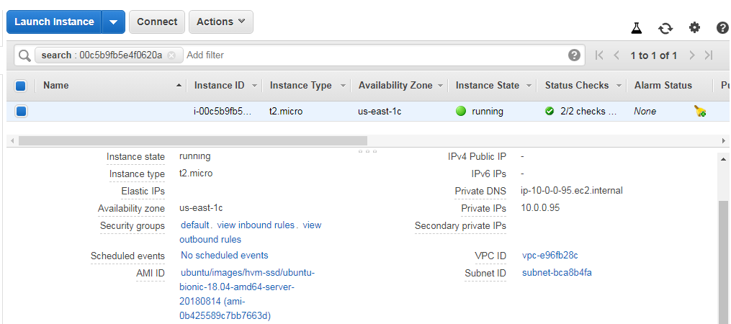

Slide 49
Terraform State File
andy@shoggoth:terraform$ terraform plan -out=/tmp/foo
Refreshing Terraform state in-memory prior to plan...
The refreshed state will be used to calculate this plan, but will not be
persisted to local or remote state storage.
aws_instance.example1: Refreshing state... (ID: i-00c5b9fb5e4f0620a)
------------------------------------------------------------------------
No changes. Infrastructure is up-to-date.
This means that Terraform did not detect any differences between your
configuration and real physical resources that exist. As a result, no
actions need to be performed.

Slide 50
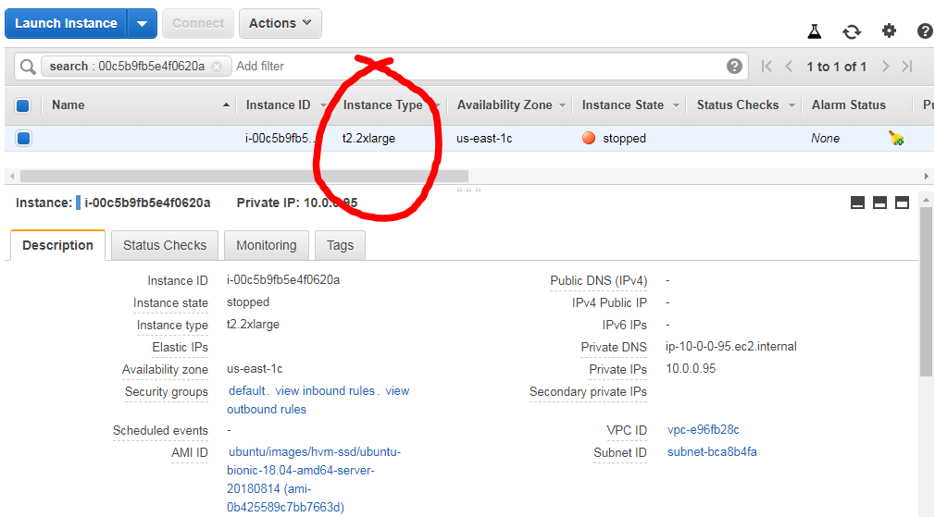

Slide 51
Terraform State File
andy@shoggoth:terraform$ terraform plan -out=/tmp/foo
:
An execution plan has been generated and is shown below.
Resource actions are indicated with the following symbols:
~ update in-place
Terraform will perform the following actions:
~ aws_instance.example1
instance_type: "t2.2xlarge" => "t2.micro"
Plan: 0 to add, 1 to change, 0 to destroy.
:

Slide 52
Terraform State File
andy@shoggoth:terraform$ terraform apply "/tmp/foo"
aws_instance.example1: Modifying... (ID: i-00c5b9fb5e4f0620a)
instance_type: "t2.2xlarge" => "t2.micro"
aws_instance.example1: Still modifying... (ID: i-00c5b9fb5e4f0620a, 10s elapsed)
aws_instance.example1: Still modifying... (ID: i-00c5b9fb5e4f0620a, 20s elapsed)
aws_instance.example1: Still modifying... (ID: i-00c5b9fb5e4f0620a, 30s elapsed)
aws_instance.example1: Still modifying... (ID: i-00c5b9fb5e4f0620a, 40s elapsed)
aws_instance.example1: Modifications complete after 42s (ID: i-00c5b9fb5e4f0620a)
Apply complete! Resources: 0 added, 1 changed, 0 destroyed.
andy@shoggoth:terraform$

Slide 53
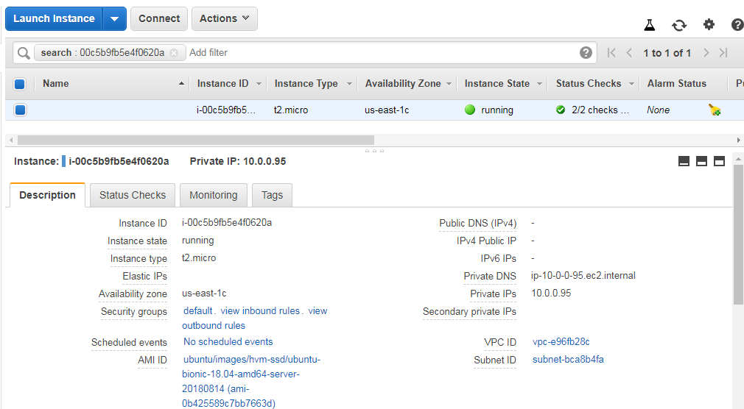

Slide 54
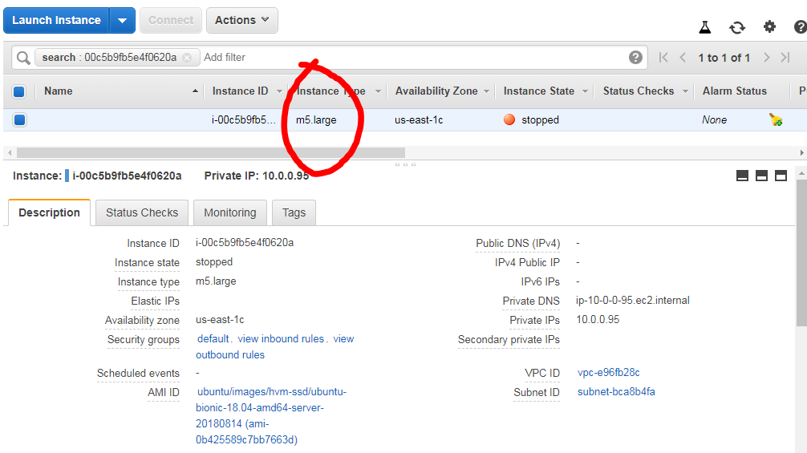

Slide 55
Terraform State File
andy@shoggoth:terraform$ terraform plan -out=/tmp/foo
:
-/+ destroy and then create replacement
Terraform will perform the following actions:
-/+ aws_instance.example1 (new resource required)
id: "i-00c5b9fb5e4f0620a" => <computed> (forces new resource)
:
ebs_optimized: "true" => "false" (forces new resource)
:

Slide 56
Terraform State File
andy@shoggoth:terraform$ terraform apply "/tmp/foo"
aws_instance.example1: Destroying... (ID: i-00c5b9fb5e4f0620a)
aws_instance.example1: Still destroying... (ID: i-00c5b9fb5e4f0620a, 10s elapsed)
:
aws_instance.example1: Destruction complete after 40s
aws_instance.example1: Creating...
ami: "" => "ami-0b425589c7bb7663d"
:
aws_instance.example1: Still creating... (10s elapsed)
aws_instance.example1: Still creating... (20s elapsed)
aws_instance.example1: Still creating... (30s elapsed)
aws_instance.example1: Creation complete after 31s (ID: i-09c0fb297966a2fbd)
:

Slide 57
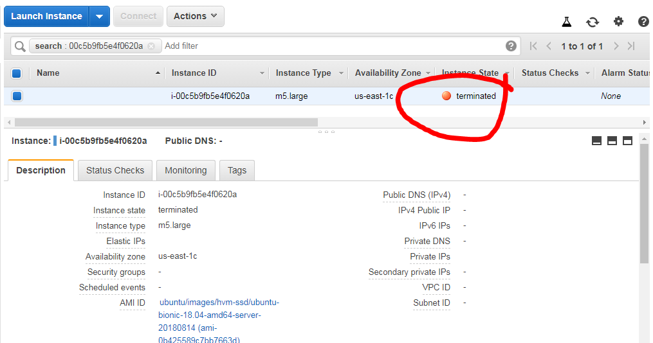

Slide 58
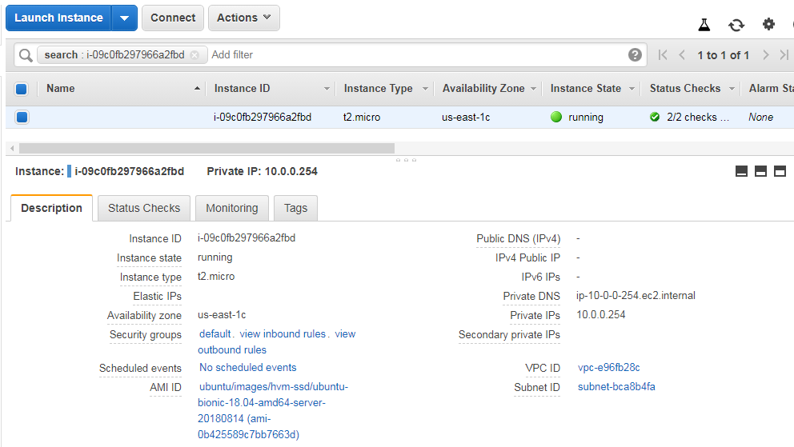

Slide 59


Slide 60
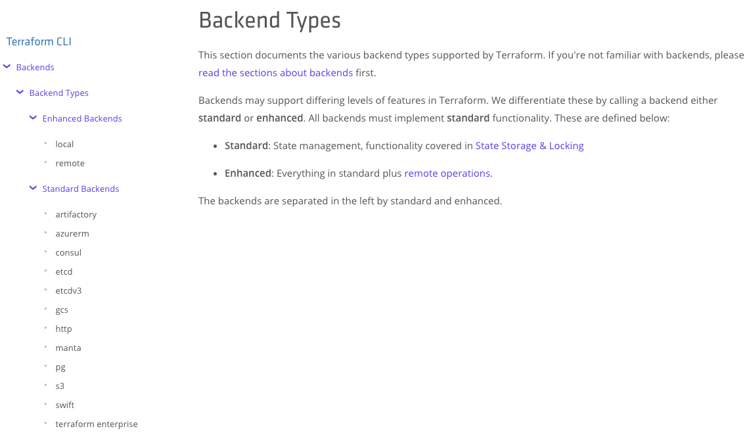

Slide 61
Terraform S3 Remote
andy@shoggoth:terraform$ cat main.tf
terraform {
backend "s3" {
bucket = "tf-state-0627117936405"
key = "obama-and-me"
region = "us-east-1"
}
}
:

Slide 62
Terraform Delete
andy@shoggoth:terraform$ terraform destroy
aws_instance.example1: Refreshing state... (ID: i-09c0fb297966a2fbd)
An execution plan has been generated and is shown below.
Resource actions are indicated with the following symbols:
- destroy
Terraform will perform the following actions:
- aws_instance.example1
Plan: 0 to add, 0 to change, 1 to destroy.
Do you really want to destroy all resources?
Terraform will destroy all your managed infrastructure, as shown above.
There is no undo. Only 'yes' will be accepted to confirm.
Enter a value:

Slide 63
Terraform Delete
:
Do you really want to destroy all resources?
Terraform will destroy all your managed infrastructure, as shown above.
There is no undo. Only 'yes' will be accepted to confirm.
Enter a value: yes
aws_instance.example1: Destroying... (ID: i-09c0fb297966a2fbd)
aws_instance.example1: Still destroying... (ID: i-09c0fb297966a2fbd, 10s elapsed)
aws_instance.example1: Destruction complete after 20s
Destroy complete! Resources: 1 destroyed.
andy@shoggoth:terraform$

Slide 64
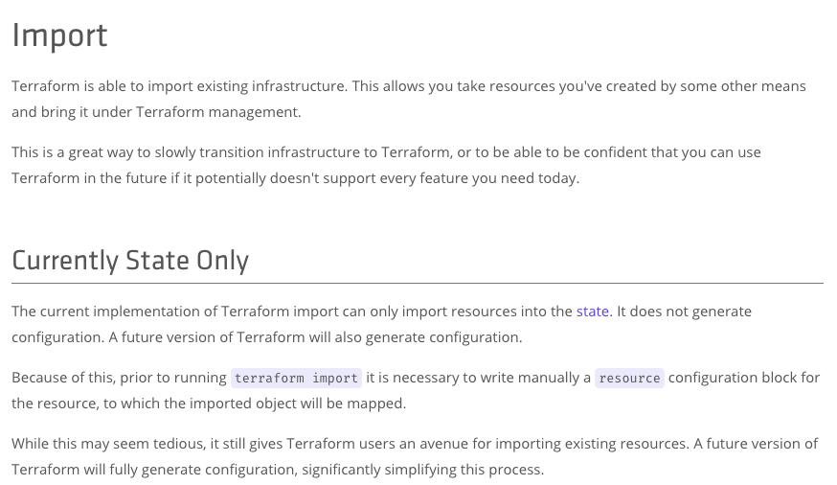

Slide 65
Terraform Import
andy@shoggoth:terraform$ terraform import aws_instance.example1 i-09e533261fd908e45
aws_instance.example1: Importing from ID "i-09e533261fd908e45"...
aws_instance.example1: Import complete!
Imported aws_instance (ID: i-09e533261fd908e45)
aws_instance.example1: Refreshing state... (ID: i-09e533261fd908e45)
Import successful!
The resources that were imported are shown above. These resources are now in
your Terraform state and will henceforth be managed by Terraform.
andy@shoggoth:terraform$

Slide 66
Terraform Import
andy@shoggoth:terraform$ terraform plan
Refreshing Terraform state in-memory prior to plan...
The refreshed state will be used to calculate this plan, but will not be
persisted to local or remote state storage.
aws_instance.example1: Refreshing state... (ID: i-09e533261fd908e45)
------------------------------------------------------------------------
No changes. Infrastructure is up-to-date.
This means that Terraform did not detect any differences between your
configuration and real physical resources that exist. As a result, no
actions need to be performed.

Slide 67
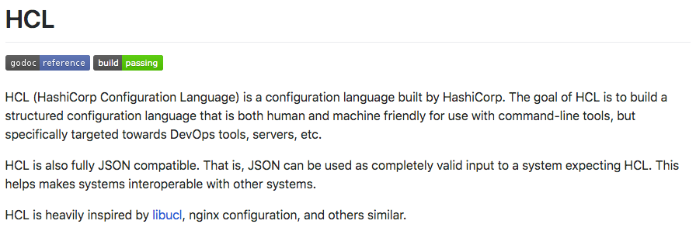
HashiCorp Configuration Language

Slide 68
HCL References
In general, you’ll see a lot of the following format:
"${TYPE.NAME.ATTRIBUTE}"

Slide 69
HCL References
:
resource "aws_security_group" "db_access" {
:
}
resource "aws_instance" "example1" {
:
vpc_security_group_ids = [ "${aws_security_group.db_access.id}" ]
:
}
resource "aws_route53_record" "www" {
name = "www.example.com"
records = [ "${aws_instance.example1.public_ip}" ]
:

Slide 70
HCL References
:
resource "aws_security_group" "db_access" {
:
}
resource "aws_instance" "example1" {
:
vpc_security_group_ids = [ "${aws_security_group.db_access.id}" ]
:
}
resource "aws_route53_record" "www" {
name = "www.example.com"
records = [ "${aws_instance.example1.public_ip}" ]
:

Slide 71
HCL Variables
andy@shoggoth:tf-hd$ cat vars.tf
variable "environment" { default = “dev” }
:
andy@shoggoth:tf-hd$ cat main.tf
resource "aws_route53_record" "www" {
:
name = "www.${var.environment}.example.com"
records = [ "${aws_eip.elb.public_ip}" ]
}
:
andy@shoggoth:tf-hd$ terraform apply -var environment=prod

Slide 72
HCL Data Sources
data "aws_ami" "web" {
filter {
name = "state"
values = ["available"]
}
filter {
name = "tag:Component"
values = ["web"]
}
most_recent = true
}
:
resource "aws_instance" "web" {
ami = data.aws_ami.web.id
:

Slide 73
Multiple Provider Example
Putting it all together

Slide 74
Terraform Enterprise
Get your checkbook out...no, not that one. The big one...

Slide 75
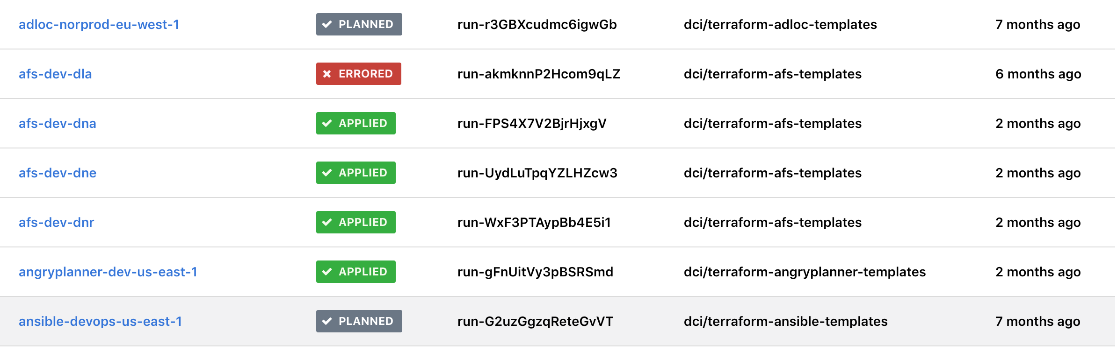

Slide 76
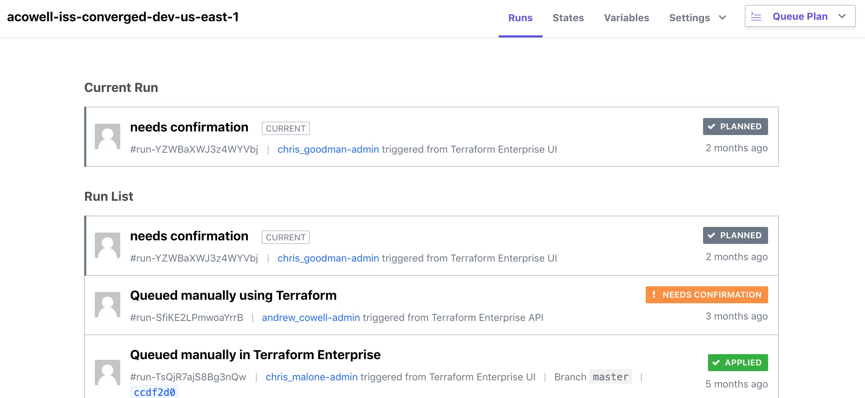

Slide 77
Terraform vs CloudFormation
The big question: which is better?

Slide 78
Accessing 3rd Party Services?
Advantage: Terraform
Why?
An explicit emphasis on providers has generated a wealth of pre-written 3rd party providers.
HOWEVER: If you have to write your own access to a 3rd party service, it’s easier to accomplish in CloudFormation.

Slide 79
Readability and Clarity?
Advantage: CloudFormation
Why?
CloudFormation automatically identifies resources as provisioned by CloudFormation.
Stacks tend to be more granular thus templates are more easily understood.
No repeated usage of the same file names.
You can now use YAML and not JSON...

Slide 80
Importing Existing Resources?
Advantage: Terraform
Why?
CloudFormation doesn’t have this capability.

Slide 81
Monitoring and Correcting Changes to Resources?
Advantage: Terraform
Why?
CloudFormation has only recently gotten the ability to automatically detect drift, but still won’t automatically remedy it. You would think this feature would be coming...

Slide 82
Error Handling?
Advantage: CloudFormation
Why?
CloudFormation will attempt to rollback changes that have errors to a previously correct state. Terraform will not.

Slide 83
Cost?
Advantage: CloudFormation
Why?
Both largely usable for free, but CloudFormation is always free, and gets support through the MUCH more economical AWS support system. Terraform goes from 0 to Oracle...

Slide 84
Usability?
It’s a wash
Why?
They really are two different things-- Terraform is a solution, while CloudFormation is a tool. If you have a person managing things, Terraform has the advantage; however, if it’s part of automation, CloudFormation has the advantage.

Slide 85
THE END

Slide 86
http://bit.ly/2UbOyl0

Slide 87

http://web.lopsaetenn.org/

Slide 88
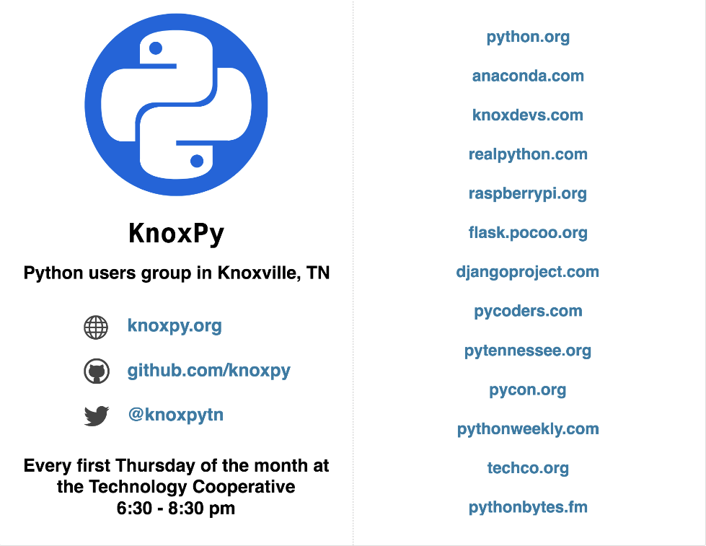

Slide 89
Credits
Special thanks to all the people who made and released these awesome resources for free:
Presentation template by SlidesCarnival
Photographs by Unsplash

Slide 90
Presentation design
This presentation uses the following typographies and colors:
Titles: Roboto Slab
Body copy: Abel
You can download the fonts on these pages:
https://www.fontsquirrel.com/fonts/roboto-slab
https://www.fontsquirrel.com/fonts/abel
Teal #2ac7d7 · Sky #0d7fd1 · Indigo #184de2
You don’t need to keep this slide in your presentation. It’s only here to serve you as a design guide if you need to create new slides or download the fonts to edit the presentation in PowerPoint®

Slide 91
SlidesCarnival icons are editable shapes.
This means that you can:
Resize them without losing quality.
Change line color, width and style.
Isn’t that nice? :)
Examples:

Slide 92
😉
Now you can use any emoji as an icon!
And of course it resizes without losing quality and you can change the color.
How? Follow Google instructions https://twitter.com/googledocs/status/730087240156643328
✋👆👉👍👤👦👧👨👩👪💃🏃💑❤😂😉😋😒😭👶😸🐟🍒🍔💣📌📖🔨🎃🎈🎨🏈🏰🌏🔌🔑 and many more...

