Slide 1
Knoxville ETSA June 3rd, 2025
SAM
Making AI Work for You: Learn simple but powerful prompting techniques to get better, more useful results from AI—whether you're solving business challenges, writing creatively, or just making life a little easier.
The Next Wave: Agentic AI: Discover how AI is moving beyond chatbots and automation into systems that can plan, adapt, and act independently.
Building for the AI Era: Get a behind-the-scenes look at how AI is changing data center design, and why power and cooling innovations are becoming critical to support the next generation of technology.
Notes:
SAm,

Slide 2


Slide 3




https://www.sonarmentalhealth.com/
Notes:
Field-trip – No pop quiz or dogs
More familiar – your days
Lockers/Squeak - Mascot / colors / pep
Imagine change
Sonny has time - Digital Companion 24/7
Built with mental health
Meet where they are
report-card and disappointment
no words 2 express
Sonny can chat and recognize
Woked with 100’s & help identify
Quietly
Skepticism
50 districts
Jon – navigate how to put AI to work
Not abstract – not slides – not labs
Real wolrd – where impact matters – complex is real

Slide 4

Jon Duren
AI Enthusiast

Slide 5

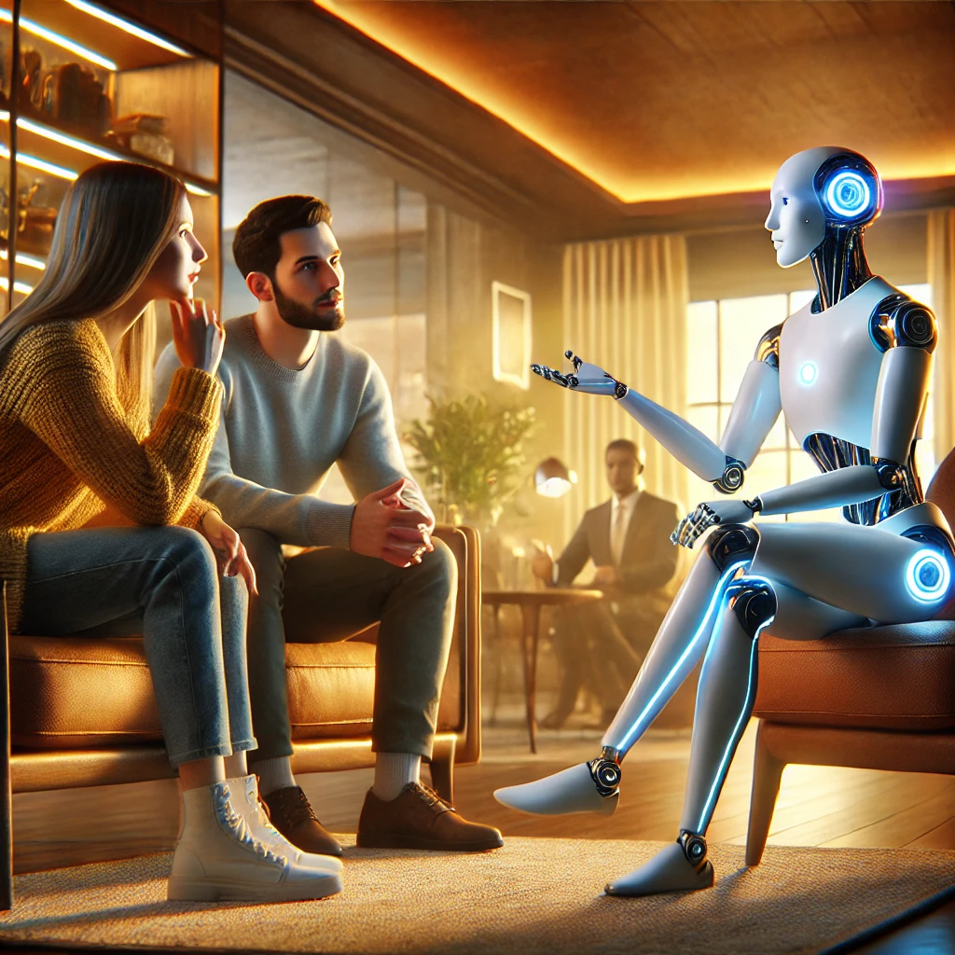
Making work for you
You never told us you knew that.
You never asked.
Learn simple but powerful prompting techniques to get better, more useful results from AI - whether you're solving business challenges, writing creatively, or just making life a little easier.
Notes:
Liz
Prompt engineering is the art of crafting precise queries that help an AI, like a large language model (LLM), provide the most helpful response possible. It's about shaping the AI's understanding by giving it clear, focused queries that help it grasp the context and nuances of what you're asking. When done effectively, it leads to responses that are more relevant, accurate, and aligned with what you need.
Think of it as guiding a smart assistant: the clearer your request, the more likely their results will meet you needs.
Prompt engineering is on-demand access to intelligence

Slide 6

Prompt Blueprint
Required
Tasks/Instructions
Context
Constraints / Negatives
Persona
Output Format
Tone/Style
Examples
Optional
Notes:
SAM
This is this anatomy of a prompt. You don’t necessarily need to have all of these parts. If you’re just using it to search for information you can get way with just telling it what you want to learn about. But adding in additional information for it to consider will advance you prompts. I want to encourage you to play with adding in this information.

Slide 7
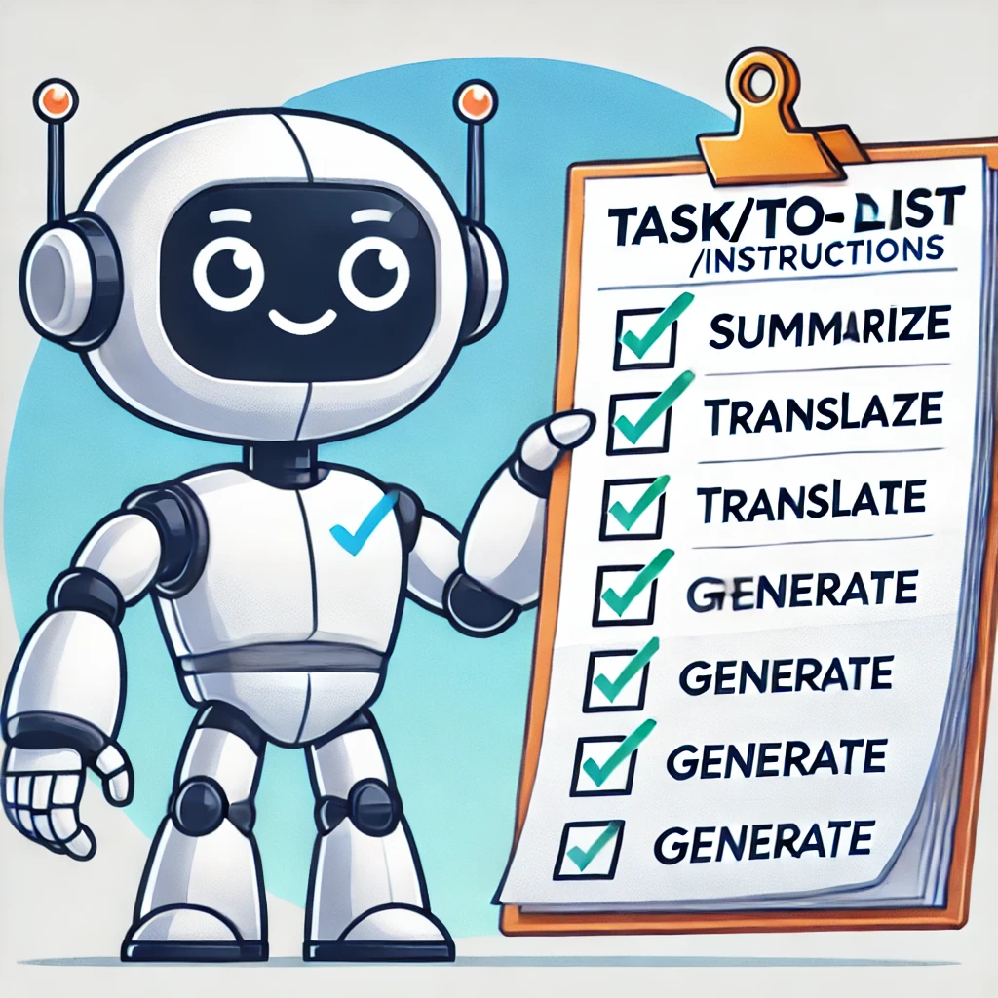

Tasks/Instructions
What: Specifies the goal or action required.
Why?: Focuses the AI's output on the desired outcome. Can be a single task or ”prompt chaining”.
Think verbs:
Create Explain Analyze Display Write Modify | Generate Summarize Paraphrase Answer Classify
Task
Context
Constraints
Persona(s)
Output
Format
Tone/Style
Notes:
SAM

Slide 8
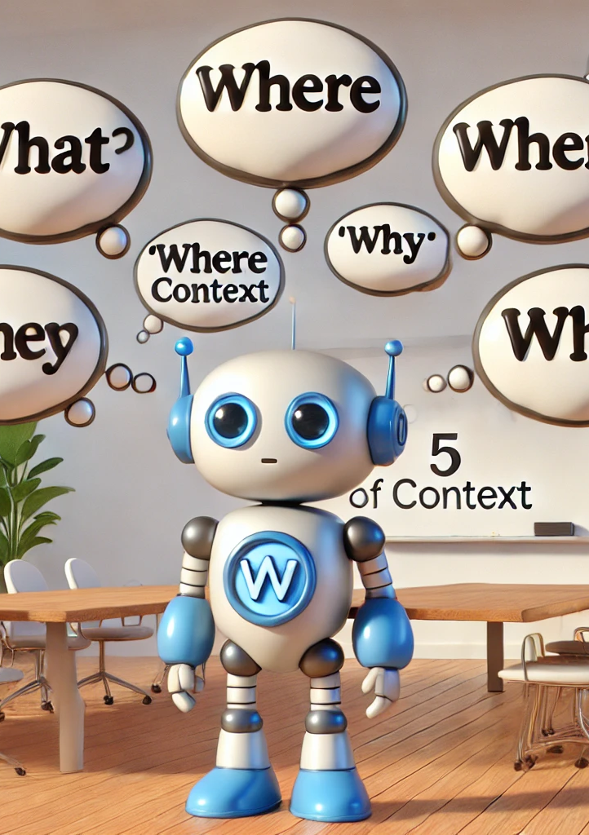
Context
What: Provide additional info or specificity for the request.
Why?: Context narrows down the possible interpretations and aligns the response with the specific scenario.
Think 5Ws (who, what, where, why, when) and How:
For a <role>… | Focused on… | From the past 3 months… | Over the next year…
Targeted to key stakeholders… | Including…. | In response to concerns about… | Relevant to <industry>…
From the perspective of… | As part of a broader strategy on… | Incorporating feedback from… | Based on market trends…
Task
Context
Constraints
Persona(s)
Output
Format
Tone/Style
Notes:
LIZ

Slide 9
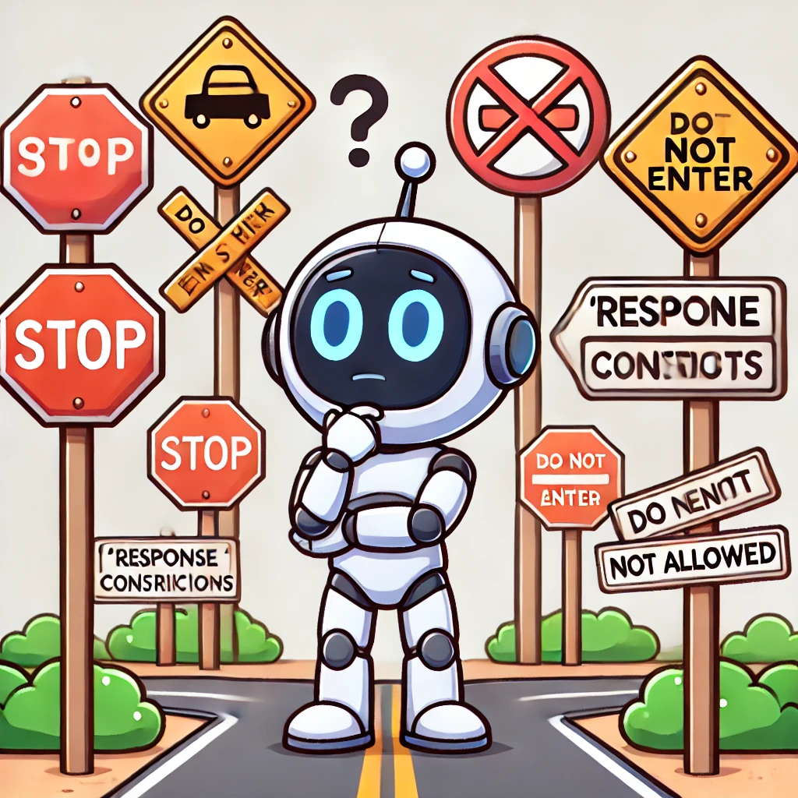
Constraints / Negatives
What: Specifies what AI should avoid, emphasize, structure, or adhere to logically.
Why?: Reduces ambiguity and keeps the response relevant.
Think boundaries, keywords such as:
Only Exclude Avoid Without Limit to Do not Must be | Narrow down Prioritize Use a maximum of Adhere to Within a range In a single Under the condition that
Task
Context
Constraints
Persona(s)
Output
Format
Tone/Style
Notes:
SAM

Slide 10

Persona(s)
What: Defines what the AI’s role or identity.
Why?: Aligns responses with specific expertise or style.
Think role: As a… / Play the role of… / From the perspective of…
Expert Consultant in Utilities | Marketing Specialist | Technical Writer familiar with AI | Customer Insight Analyst
Research Assistant | Principle Architect in HPA | Blog Writer with a background in Cybersecurity | Sales Strategist
Storyteller | Fact checker | Abraham Lincoln | Data Analyst
Task
Context
Constraints
Persona(s)
Output
Format
Tone/Style
Notes:
LIZ

Slide 11
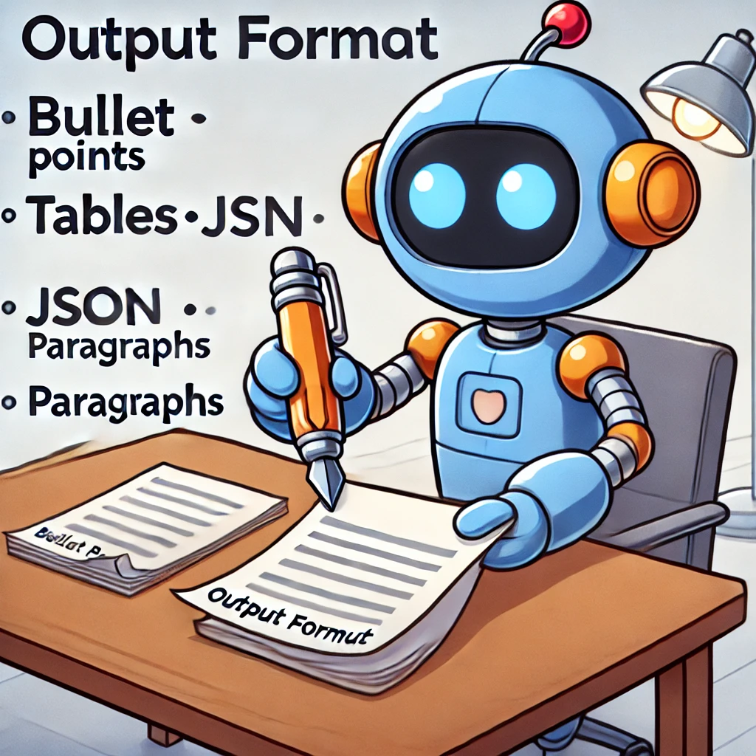
Output Format
What: Specifies how the output should be presented, whether as paragraphs, bullet points, tables, JSON, lists, or any other format that suits the use case.
Why?: A well-defined output format ensures the response is clear, actionable, and tailored to the task, saving time and improving usability and consistency.
Think structure:
Table Matrix E-mail Bullet points | Computational output Code output File output Interactive
Task
Context
Constraints
Persona(s)
Output
Format
Tone/Style
Notes:
SAM

Slide 12
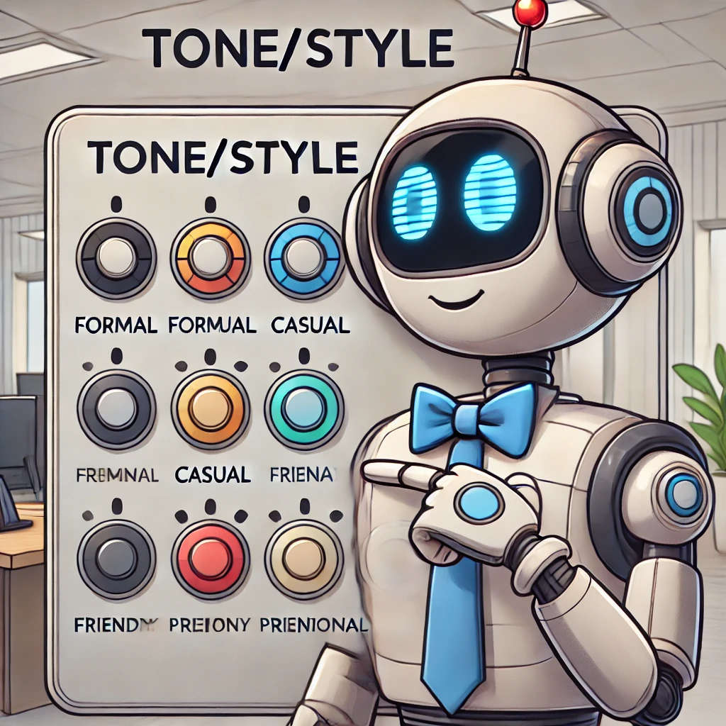
Tone/Style
What: Describes the tone or manner of the response.
Why?: Tailors the communication to fit the intended audience.
Think adjectives that describe a tone or style
Concise Professional | Empathetic | Detailed | Accessible
Analytical | Engaging | High-level | Polished
Challenging | Collaborative | Urgent | Neutral
Direct Informal | Visionary Technical | Caring Persuasive | Bold
Task
Context
Constraints
Persona(s)
Output
Format
Tone/Style
Notes:
LIZ

Slide 13
Elements of a Prompt - Having Optimal Conversations With Data
Most Important
Task/Instruction
Response Constraints / Negatives
Persona(s) (who you are, who it is for)
Output Format
Tone/Style
Specifies the goal or action required
Limit the possibilities; enable the model to understand the specific situation
How the LLM is to construct the output.
Specify the way you want the output to be presented? (i.e., emails, bullet points, matrices, code blocks/markdown, paragraphs)
If unsure of the tone "word" to use, explain to the LLM the feeling you are after
Context
Background or situational details; frame the task for relevance and focus
Examples
Demonstrating the desired outcome/reasoning process
Mandatory
Important
Nice-to-Have
Optional
Notes:
SAM

Slide 14




Common Mistakes in Writing Prompts
I want to know absolutely everything that has happened up to now.
Vague or open-ended prompts
AI can’t read minds
Ensure relevant context and critical details are present
Overly complex language or structure
Break into a series of prompts to more easily manage
False expectations
No AI will best the human imagination and perception
First, the Earth cooled, and then the dinosaurs came…
Looks like I picked the wrong week to quit good prompting.
https://www.youtube.com/watch?v=MabLtuTpDw8
Notes:
SAM
False expectations: that’s why ”copilots” exist. The Human is in the driver’s/pilot’s seat.

Slide 15

Earl J. Dodd
High-Performance Comedian

Slide 16
The Next Wave: Agentic AI
SAM
Discover how AI is moving beyond chatbots and automation into systems that can plan, adapt, and act independently.
Notes:
SAm,

Slide 17
The next phase of AI: Agentic
Proactive Partner in Work
A new generation of AI that’s a little less “Siri” and a little more “digital teammate.”

Slide 18
OpenAI – 6 use case primitives
Most use cases fall into one of six primitives, which they define as fundamental use case types that apply across all departments and disciplines
Content Creation: AI assists in generating content—be it drafting emails, creating marketing materials, or writing reports. It's about enhancing creativity and productivity.
Automation: Streamlining repetitive tasks, such as data entry or scheduling, allowing teams to focus on more strategic activities.
Research: AI aids in gathering and synthesizing information, accelerating the research process across industries.
Coding: From suggesting code snippets to debugging, AI supports developers in writing and maintaining code more efficiently.
Data Analysis: AI processes large datasets to uncover insights, identify trends, and support data-driven decision-making.
Ideation and Strategy: AI contributes to brainstorming sessions, offering new perspectives and strategic recommendations.
https://cdn.openai.com/business-guides-and-resources/identifying-and-scaling-ai-use-cases.pdf

Slide 19
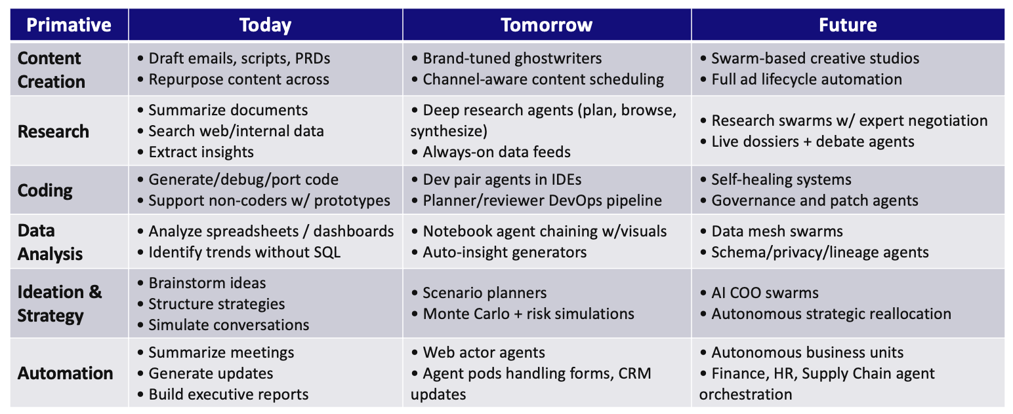
OpenAI – 6 use case primitives
Notes:
Star-trek – Nebula Analysis

Slide 20
Building for the AI era
SAM
Get a behind-the-scenes look at how AI is changing data center design, and why power and cooling innovations are becoming critical to support the next generation of technology.
Notes:
SAm,

Slide 21
Domains of Change!
Facilities
Network
Storage
Data
Software
Management
Tools
security
Compute
Automation

Slide 22




Outcome Approach to Future-Proofing
Horizon 0 (Yesteryear)
Horizon 1
(Today-2 Years)
Horizon 2
(2-8 Years)
Compute Centric
Brownfield Data Center
Standard (Classic) Ecosystem
Cloud First
Accelerator Centric
Hybrid Data Center
Computational Networks
Decoupled (Disaggregated Composability)
Changing Landscapes
Cloud Appropriate
Data Centric
Edge Data Center
Everything-as-a-Service
Computational Memory & Storage
Consumption-based Models
Silicon Photonics
Autonomic (AI/Dev/Sec/Ops)
Transactional Architectures
Translational Architectures
Transformational Architectures

Slide 23
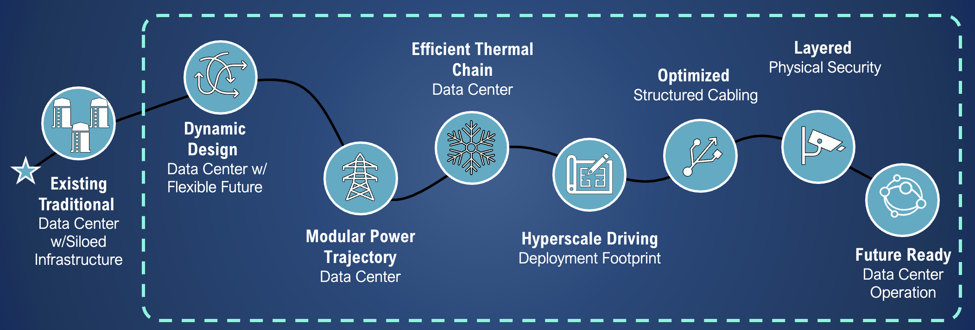
Journey to Infrastructure Innovation

Slide 24
HPA Architectures & Technology Landscape
Transactional
Transitional
Transformational
Architecture
Compute Centric
Brownfield DC
Standard (Classic) Ecosystem
Cloud First
Accelerator Centric
Hybrid Data Center
Computational Networks
Decoupled (Disaggregated Composability)
Changing Landscapes
Cloud Appropriate
Data On-Demand Centric
Edge Data Center & Modular Data Center
Everything-as-a-Service
Computational Memory & Storage
Consumption-based Models
Silicon Photonics
Autonomic (AI/Dev/Sec/Ops)
Technology
General purpose compute
Accelerator
Memory (CXL, HBM, GDDR, SCM, Non-Volatile)
Specialty
Other Technology
Analog Processor (Ultra-low Power)
Quantum (QC Universal Gate, QN)
Photonics (Interconnect, Backplane)
Computational Infrastructure
Storage
Memory
Networks
Chip 3D printing (<< 100 nm)
Intel, AMD x86-64
ARM 64FX
IBM POWER
RISC-V
Tachyum Prodigy
Composable Disaggregation (CDI)
CXL
GPU
FPGA
Google TPU
NVIDIA DPU
Groq TSU
Graphacore IPU
Apple A/M
Google Whitechapel
Transputer
Cerebras WSE
Intel Nirvana
Knupath Hermosa
“MemFrame” Pliops InspireSemi Thunderbird
Digital Twins Next Silicon
Quantum Computing (annealed processor, accelerator cards)
Quantum Simulation (algorithm appropriateness)
Photonics (SOC, Chiplet)
Chip 3D printing (~200 nm)

Slide 25
Technology Horizons
Horizon 1
Horizon 2
General Purpose Compute
Intel, AMD x86-64
ARM 64FX
IBM POWER (RISC-64)
RISC-V
Tachyum Prodigy
Quantum
QC Universal Gate Accelerators
QN
Photonics (Interconnects, Backplanes)
Analog Processors (ultra-low power)
Computational Memory
Computational Storage
Computational Network
Chip 3D Printing <<100 nm
Memory
Volatile, “MemFrame”
HBM, SCM, DIMM
CXL
Accelerator
GPU, FPGA
CXL,CDI
Pliops
Other Technology
Switchless Networks
Chip 3D Printing ~200 nm
Specialty (too many to list)
Google TPU
NVIDIA DPU
Groq TSU
Transputer (they are back)
Apple A/M (products)
Google Whitechapel (Pixel)
Graphcore IPU
Cerebras WSE
Intel Nervana
Knupath Hermosa
Other Technology
Quantum Computing (Annealed processor, accelerator cards)
Quantum Simulation (Algorithm Appropriateness)
Photonics (SOC Chiplet)
Digital Twins
[Most Notable…No Endorsement]

Slide 26
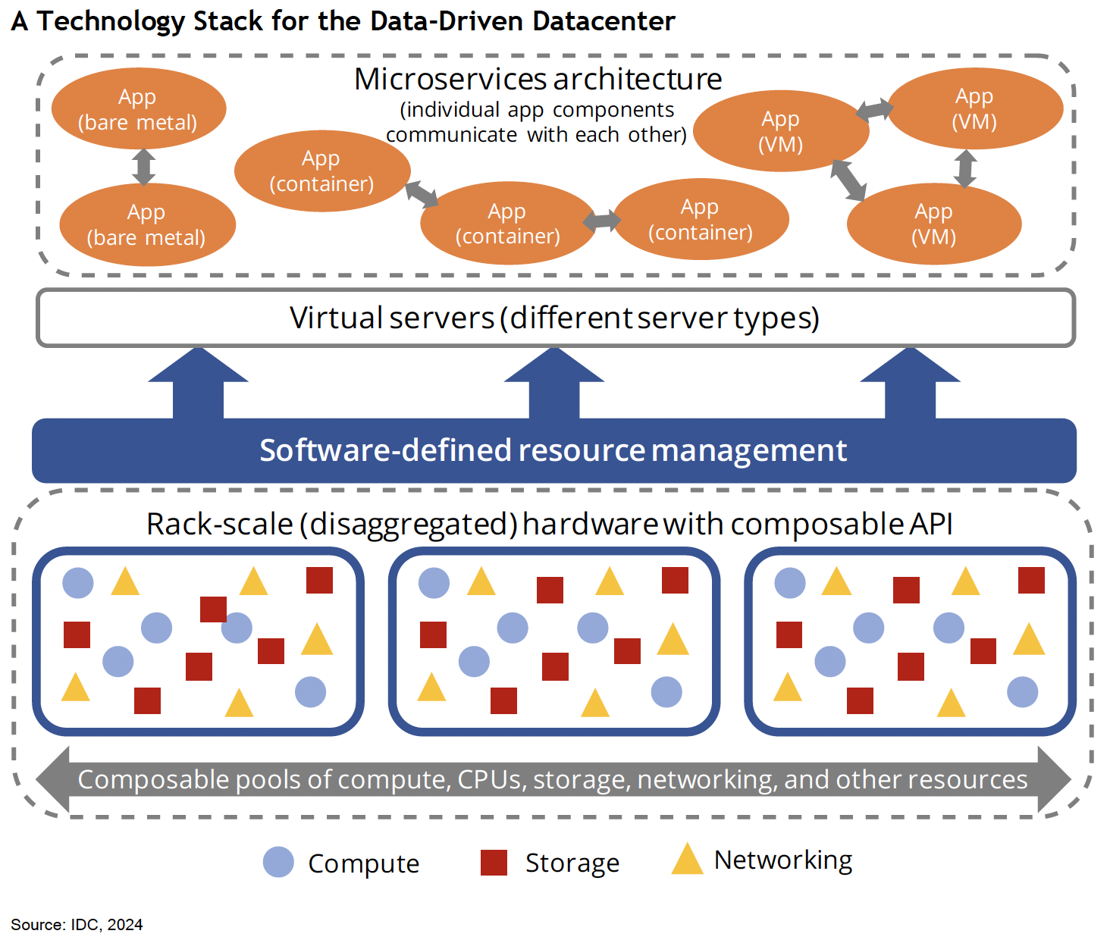
Composability & Disaggregation
Composable Disaggregated Infrastructure (CDI)
Gartner describes CDI as a complex value chain that involves multiple steps, each requiring specialized skills. Gartner recommends breaking down the CDI value chain into seven processes to evaluate requirements and capabilities.
CDI Characteristics
Rack-Scale
Resources Pools
Software-Defined
Automation
Scalability
Agility
Futureproofing

Slide 27

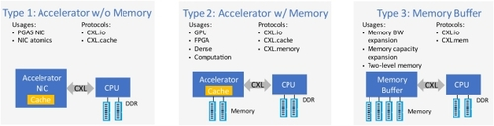
Compute Express Link
Compute Express Link (CXL) is an open standard interconnect that provides high-bandwidth, low-latency connections between host processors and devices such as accelerators, memory buffers, and smart adapters.
CXL Benefits
High-Bandwidth Performance
Low-Latency Performance
Resource Pooling
Scalability
Agility
Futureproofing

Slide 28

Advanced Technology (Example)
Compute Front-End Network (Ethernet)
Spine
Spine
Mngt Spine
Drut Technologies DX3 and Photonics
A vPOD is a grouping of shared resources (CPUs, Operating System(s), GPU(s), Memory, NICs) in a secure user/workload entity
vPODs are reconfigurable and begin the process of bringing dynamic configurability to what are difficult to configure static siloes
vPODs can span different physical servers
vPODs utilize any GPU back-end network – InfiniBand, RoCE and Photonic
CPU Leaf
CPU Leaf
CPU Leaf
CPU Leaf
Storage Leaf
Mngt Leaf
GPU Server
GPU Server
GPU Server
GPU Server
Bare Metal Management Server OS Hypervisor
GPU
GPU
GPU
GPU
GPU
GPU
GPU
GPU
GPU
GPU
GPU
GPU
GPU
GPU
GPU
GPU
GPU
GPU
vPOD
vPOD
vPOD
vPOD
vPOD
vPOD
NIC
NIC
NIC
NIC
NIC
NIC
NIC
NIC
NIC
NIC
NIC
NIC
NIC
NIC
NIC
NIC
NIC
NIC
System
Loop
GPU Backend Network – InfiniBand / RoCE / Photonic
Interconnect Resource Groupings
GPU Isolation
Dynamic Allocation
Drut Software Platform
Drut Fabric Manager
Drut ML/AI Workbench
Software Appliances
DX 3.0 Virtual Disaggregation for GPU Servers Made Easy
[No Endorsement]

Slide 29
Review & Relevancy
Rapidly Expanding Landscape for Accelerators (GPU, FPGA, Quantum, Analog)
Beyond Hardware / Software Stacks
Convergence at any scale
Data-centric computing
Everything as a Service (XaaS)
Solution Alignments
Architecture Flexibility & Futureproofing
Aggregation / Disaggregation / Resource Pooling
Software-defined Everything
Automate Everything
Provisioning—Scheduling—Orchestration—Meta Orchestration
People Skills are “the” Critical Resource

Slide 30
Questions? https://www.wwt.com

